Slide 1

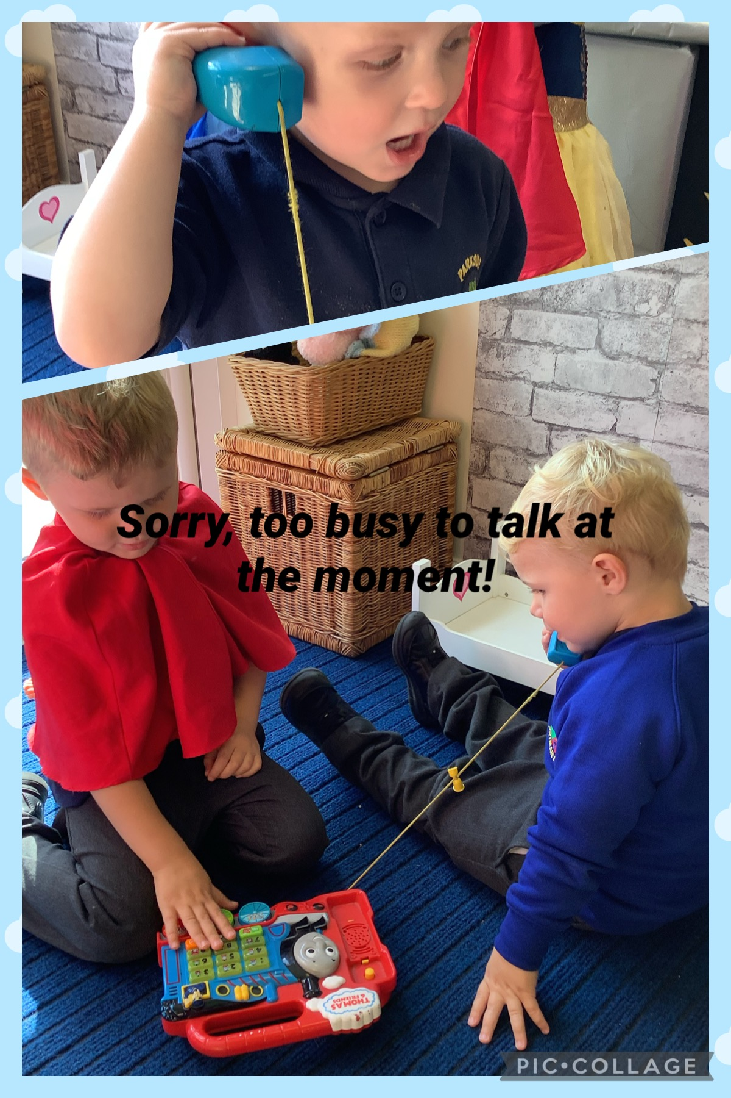
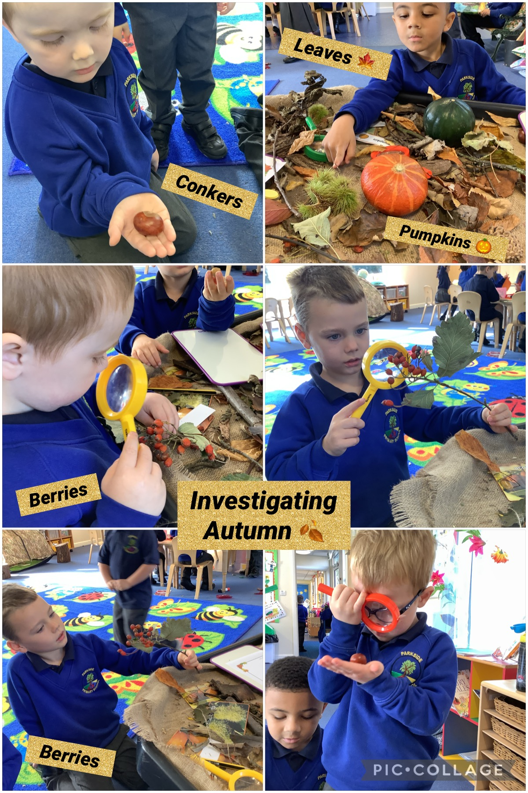
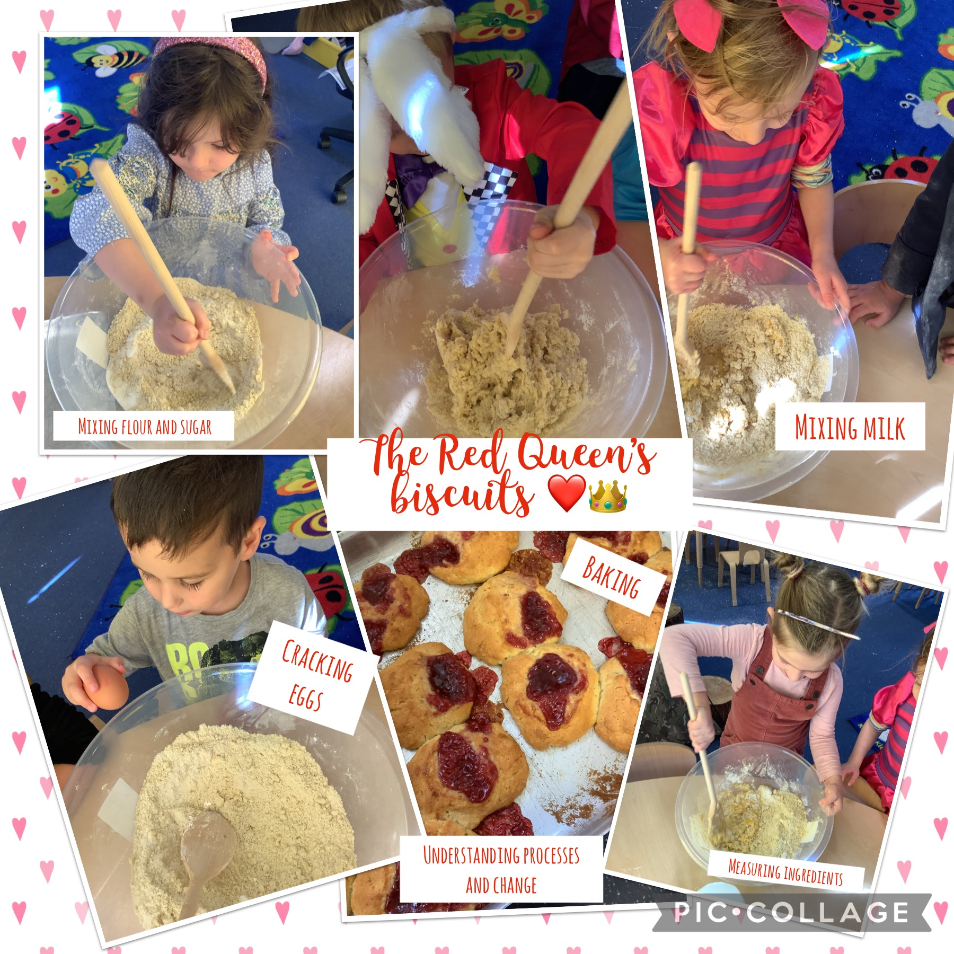
Parkside Primary School
Early Years Curriculum
Proud to be Parkside
“Come as you are and leave as a Champion”

Slide 2
EYFS Intent, Implementation and Impact
INTENT
In our Early Years setting, we believe in creating a space where every child is nurtured, connections blossom, and the seeds of lifelong learning are sown with care. Recognising the pivotal role of these formative years, we focus on fostering communication, learning through play, a love of reading and high-quality interactions and connections whilst embracing the uniqueness of each and every child. Learning is an adventure at Parkside, our immersive, play-based activities spark curiosity, create a love for exploration and a thirst for knowledge.
Our Nursery and Reception classes are special places where we believe that our children deserve the best possible start to begin their exciting Parkside journey. Our aspiration is to be an outstanding provision where each child's journey is filled with opportunities that encourage children to take risks, make mistakes and be resilient learners. We strive to foster a love for learning that lasts a lifetime, laying the groundwork to create kind, independent, resilient, determined, respectful and proud individuals. We view development holistically, so our Early Years curriculum is designed to be tangible and theme-based; providing our pupils with knowledge, self-belief and cultural capital to ensure they are ‘school ready’ when they leave the Early Years.
We celebrate and welcome differences which enables all children to flourish. In each setting, we believe that early childhood should provide happiness, limitless curiosity and a hunger for learning. At Parkside we strive to ensure that at the end of each day all children leave happy, knowing more and are able to do more in all areas of learning.
The Explorers/Adventurers
Our youngest children are The Explorers. This room provides opportunities for our children to foster warm and nurturing relationships with their key workers. We prepare our children to be lifelong learners through consistent and embedded routines. Learning is led by our curious children’s interests and enhanced through high-quality interactions with our skilled practitioners. We promote an early exploration of the world around us. We provide a multitude of opportunities to appreciate the importance of community.
The Investigators
Our pre school children are The Investigators. This room ignites a love of learning that children will cherish throughout their school journey. We prepare our children for Reception readiness through building healthy relationships with their peers and adults alike. Learning is a collaboration of children’s curiosities punctuated with carefully planned adult led learning. We promote a wealth of opportunities to foster independence so that our children are fully equipped for their Reception pathway.
The Rangers
Our Reception classes are The Rangers. These classes lay the foundations that equip our children with a hunger for lifelong learning. We provide a multitude of opportunities that encourage our children to take risks and be resilient learners. Learning is carefully planned and sequenced so that children are able to make links between their learning. We promote a thirst for adventure through open-ended provision, allowing children to showcase determination in their independent learning.

Slide 3
EYFS Intent, Implementation and Impact
IMPLEMENTATION
Classes work collaboratively to provide an enriching, stimulating curriculum that covers each area of learning; equipping our children with the secure foundations that enable them to fulfil their potential in their current and future learning. We refer to the key documents ‘The Statutory Requirements for the EYFS’ and ‘Development Matters’ to inform the planning of our tangible and theme-based curriculum that provides our pupils with knowledge, self-belief and cultural capital to ensure they are school ready when they leave the Early Years. The curriculum is split into 7 areas of learning (3 Prime Areas and 4 Specific Areas).
Prime Areas
Personal, Social and Emotional Development (PSED) involves helping children to develop a positive sense of themselves, and others; to form positive relationships and develop respect for others; to develop social skills and learn how to manage their feelings; to understand appropriate behaviour in groups; and to have confidence in their own abilities.
Communication and Language Development involves giving children opportunities to experience a language rich environment; to develop their confidence and skills in expressing themselves; and to speak and listen in a range of situations.
Physical Development involves providing opportunities for young children to be active and interactive; and to develop their co-ordination, control, and movement. Children must also be helped to understand the importance of physical activity, and to make healthy choices in relation to food.
Specific Areas
Literacy (Reading and Writing) involves encouraging children to link sounds and letters and to begin to read and write. Children must be given access to a wide range of reading materials (books, poems, and other written materials) to ignite their interest.
Mathematics involves providing children with opportunities to develop and improve their skills in counting, understanding and using numbers, calculating simple addition and subtraction problems; and to describe shapes, spaces, and measures.
Understanding the world involves guiding children to make sense of their physical world and their community through opportunities to explore, observe and find out about people, places, technology and the environment.
Expressive arts and design involves enabling children to explore and play with a wide range of media and materials, as well as providing opportunities and encouragement for sharing their thoughts, ideas and feelings through a variety of activities in art, music, movement, dance, role-play, and design and technology.

Slide 4
Our Early Years curriculum is underpinned by the statutory Early Years Framework and Development Matters. Development Matters provides an age-related progression map which ensures that there are no gaps in learning of skills and knowledge. To ensure consistency and appropriacy, staff plan collaboratively but practitioners have autonomy to adapt our curriculum to meet the needs of every child. The curriculum is designed around themes which alternate throughout the term. Through this theme children are able to access high-quality learning in all 7 areas of learning both indoors and outdoors.
Our enabling all-weather setting allows all children have the flexibility to follow their interests and practitioners facilitate their learning through discussion, conversation, vocabulary and enhancing resources. We recognise that routines and self-regulation are key aspects of a child’s development, and we invite them to take responsibility for their actions and routines. Practitioners facilitate small group teaching and learning sessions and ensure that the setting offers high-quality continuous provision opportunities throughout the day. We are passionate about ensuring that all our children leave Early Years with a lifelong love of stories and books therefore our Nursery settings are language rich including Nursery Rhymes, stories, songs and story times. Our children begin to develop their preferences for favourite stories and authors whilst being able to make links to their own experiences and themes.
To further enhance our children’s learning journey, Reception practitioners build on the skills and knowledge already acquired regardless of a child’s previous Early Years journey. We equip our children with the behaviours and tools so that they are school ready as they leave the Early Years.
Little Wandle: Letters and Sounds revised programme provides the basis for our whole class phonics teaching. The White Rose Maths scheme structures teaching and learning in Reception.
IMPACT
We strive to ensure that our children ‘Come you are and leave as a champion’. We define an Early Years Parkside champion as a child who embodies Kindness, Honesty, Independence, Determination, Respect; knows more and can do more and is ready for their next stage in learning.
By the end of reception, most children will achieve the early learning goals and will be ready to transition into Key Stage 1 as independent and determined learners, with the knowledge and skills they need to succeed.

Slide 5
Curriculum Progression
 | Autumn The World Around Us | Spring The Wide World | Summer The Changing World
The Explorers/ Adventurers | Marvellous Me Autumn Woodland animals Christmas Bonfire Night | Winter & Spring Mother's Day Planting seeds Easter Farm animals | Summer weather Minibeasts Our environment Father’s Day
The Investigators | All About Me Autumn Bonfire Night Christmas Farm animals offspring | Winter & Spring Chinese New Year Valentine's Day Shrove Tuesday Mother's Day Recycling Spring Planting & growing Easter | New Life Transition to school Graduation Growing Together: Seed & Animals Father’s Day
The Rangers (Reception) | Individual Me Harvest Autumn Animals and their habitats Diwali & The Gunpowder Plot Remembrance Day Christmas | Winter & Spring Around the World: Different countries Chinese New Year Spring Mother's Day Growing plants Life cycles Easter | Ramadan Different families Animals from around the world Summer

Slide 6
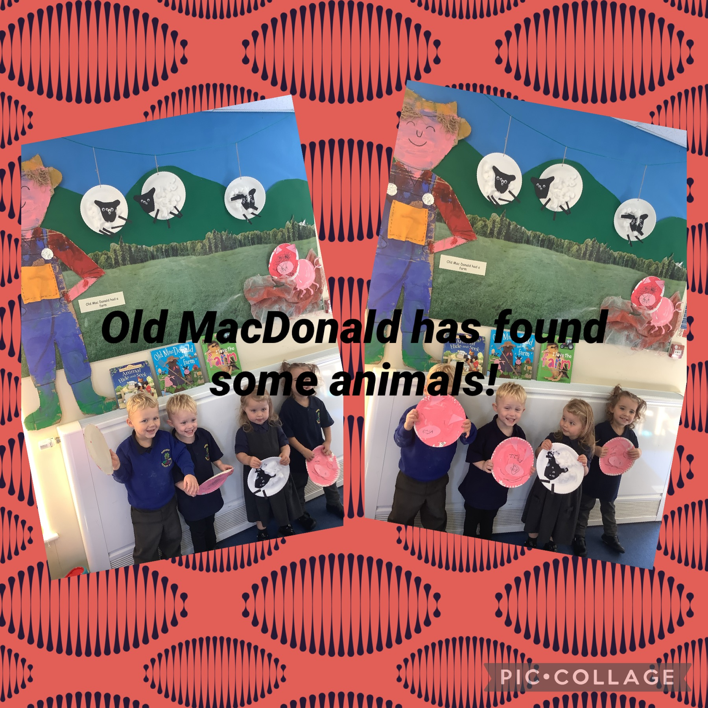
The Explorers’/Adventurers’ Curriculum

Slide 7
Explorers Termly Planner
 | Autumn | Spring | Summer
Launch Day & Celebration | Fabulous First Day Harvest crafts Christmas craft celebration Settling in Celebration Letterbox walk Nursery Rhyme week | Tiger Who Came to Tea tea-party Bakery walk
Parental Contribution | Family photographs Bedtime stories Story sacks | Parker the Parkside Bear RSPB: Big Garden Birdwatch | Teddy Bear’s Picnic Decorate a plant pot for a sunflower Painting stones for the garden
Visits/Visitors | Quilma the Hedgehog Festive Fun in the Forest |  | Farm on Wheels visit
Celebrations | Birthdays, Christmas traditions | Winnie the Pooh Day, Chinese New Year, Valentine's Day, Pancake Day, World Book Day, Red Nose Day, Mother's Day, Easter | The Queen's Jubilee, World Bee Day, World Bike Day, Father’s Day
Parkside Values | Kindness and Honesty | Pride and Determination | Respect and Determination
Forest School | Exploring the forest | Weather, bird feeders, bird watching | Gardening, planting bulbs
Key Vocabulary | Mummy, Daddy, big/little brother/sister, family, baby, Autumn, crunchy, spikey, squash, conkers, pumpkins, acorns | Birds, nests, home, weather, Winter, Spring, cold, changing, grow, showers, sunshine, rainbow, freezing, puddles | Minibeast, bugs, garden, Queen, celebrate, beanstalk, Summer

Slide 8

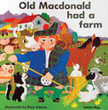


Autumn Term – Marvellous Me / Let’s Celebrate
Personal, Social and Emotional Development
We will demonstrate an understanding of our school values of kindness and honesty in action. We will settle into our new classroom and school and understand the rules we need to follow. We will learn to establish our sense of self through finding our pictures on our pegs and in our classroom. We will learn to leave our parents and go to our key workers when we come into nursery. We will learn to show our own personality traits and qualities. We will express a range of emotions to show how we are feeling. We will learn to talk about emotions through stories. We will try to do some things independently such as helping to tidy up , find our pegs and make our own choice at snack time.
Understanding the world
We will go on daily/ weekly welly walks to explore the natural materials outdoors. We will use our welly walks to gather natural materials to bring inside to fill up our treasure baskets. We will learn about some of the creatures of the forest. We will have photos of ourselves and our families in our classroom. We will talk about our families to our key workers and peers. We will celebrate the Bonfire Night and Christmas traditions. We will meet Quilma the hedgehog to help our understanding of the world around us.
Mathematics
We will post items into different objects and enjoy taking them out again. We will use our fingers to help us join in with number rhymes such as Two Little Dickie Birds. We will make sounds, point and say some numbers in sequence to help us develop our counting. We will count the children, objects in our classroom and amount of snack we can have. We will explore different spaces in the classroom that we can squeeze ourselves into. We will use large and small blocks to build. We will select the right shape to complete inset puzzles.
Physical Development
We will enjoy moving inside our classroom and in our outdoor area. We will enjoy wake up and shake up, joining in with the actions to our songs by clapping, stomping and dancing. We use our large motor skills to help us pour and tip water, sand and oats into containers. We use our fine motor skills to begin to fasten our coats. We will use the cosy coupe cars and scooters to push ourselves along. We will climb up the steps on the slide. We will learn to kick a large ball.
Literacy
We will take part in daily Nursery Rhyme time; listening to and joining in with singing songs and saying rhymes. We will copy gestures and actions that our key workers model. We will independently sing songs that we have learnt. We will spend time in our book area and will enjoy sharing books with adults and our peers. We will enjoy looking at the illustrations and noticing some of the words. We will develop our choice of a favourite book through taking home a library book each week. We will listen to a story read by an expert reader at snack time. We will have opportunities to draw using different mark making implements. We will add some marks to our drawings and will tell our key worker what the marks mean.
Communication and Language
We will make ourselves understood to our key workers using words and actions. We will start to use our words to say how we are feeling, what we like and dislike. We will start to develop conservation with our friends and key workers but we might jump from topic to topic. We will use our role play area to develop pretend play such as making a cup of tea using the toy kettle and a cup. We will use our small world area to develop our pretend play. We will use single words to name items, in context. We will understand some of the words and instructions that our key workers use everyday.
Expressive arts and design
We will join in with actions and movements to songs and music. Our daily phonics lessons will enable us to explore our voices and enjoy making sounds. We will sing songs using words that we are familiar with. We will use the music making instruments to make different noises and sounds. We will explore paint by using paintbrushes and painting with our hands, fingers and natural objects. We will investigate different materials such as playdoh, oats, leaves, sticks, bark, conkers, pumpkins, acorns and will use all our senses to explore.

Slide 9
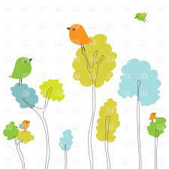
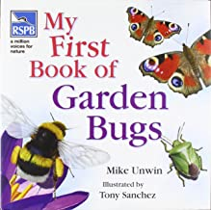
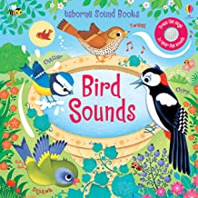
Spring Term – The Wide World
Personal, Social and Emotional Development
We will demonstrate an understanding of our school values of pride and determination in action. We will re-settle in our Nursery after the Christmas holidays and will welcome new children into our classroom. We will feel confident enough to visit our local park and explore the equipment.
Understanding the world
We will look for changes and patterns in the weather. We will look after and care for the birds in our forest area by making bird feeders. We will use binoculars for bird watching from our classroom and outdoor learning environments. We will sow seeds and will explore what a seed needs to grow. We will learn to name farm animals and will be able to make their noises. We will celebrate Chinese New Year, Valentine’s Day, Pancake Day, Mother’s Day and Easter.
Mathematics
We will continue to count in everyday contexts, such as counting how many children are here today, counting out food for snack, counting out cups for drinks. We will sometimes skip numbers when we count. We will react to changes of amount in a group of up to three items. We will compare sizes, weights using gesture and language.
Physical Development
We will use playdoh to strengthen the muscles in our arms and fingers. We will start eating independently and learning how to use a knife and fork at lunchtimes. We will learn to walk, run, jump and climb and start to use the stairs independently. We will learn to move like animals in the jungle. We will explore different materials and tools to make marks. We will use the scooters and cosy coupe cars to move around the outdoor area. We will visit the park and independently use ropes and swings.
Literacy
We will notice some print in our learning environment and will be encouraged to notice print in the stories that we share. We will use writing implements to make marks on our pictures to stand for our name. We will share and enjoy books in our reading area. We will listen to stories during our snack time.
Expressive arts and design
We will explore the different instruments and sound makers from our music basket. We will use chalk, pens, pencils, cars and paintbrushes to start to make marks intentionally on paper, chalk boards, in tuff trays and the playground. We will express our ideas and feelings through the marks that we have made. We will sometimes be able to tell an adult about the marks we have made.
Communication and Language
We will use our words and good listening as modelled by Polly Parrott. We will be encouraged to sit for a short period of time to play a game. We will sing Nursery Rhymes and songs following simple instructions such as: stop, start, fast, slow.

Slide 10


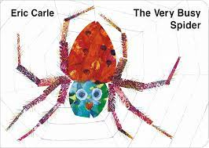



Summer Term – Growing Together
Personal, Social and Emotional Development
We will demonstrate an understanding of our school values of pride and determination in action. We will be confident in knowing and following the rules and routines. We will continue to talk about the way feel in more elaborate ways, modelled by adults. We will continue to learn to develop our control when waiting for things and recognize that some behavior can hurt others’ feelings. We will continue to increase our independence but knowing that we can ask an adult for help.
Understanding the world
We will continue to notice similarities and differences between people and our families. We will talk about the special things our Dads and special people in our lives do for us and we will say thank you on Father’s Day. We will continue to explore natural materials indoors and outdoors. We will notice detailed features of our immediate environment such as blossom on the trees and bulbs growing in our school garden and Forest. We will learn about insects and minibeasts. We will learn to name some wild animals. We will learn where insects and minibeasts live and how some of them grow and change. We will grow a variety of seeds. We will watch the seeds grow into plants. We will talk about some of the things we have learnt in Explorer’s room and look forward to moving into Nursery.
Mathematics
We will confidently say some numbers in sequence. We will continue to develop a deep understanding of numbers to 3. We will begin to subitise up to 3. We will compare objects and use mathematical language to describe them. We will begin to compare measures using gestures and simple mathematical language. We will continue to notice and arrange patterns.
Physical Development
We will continue to develop our movements and skills whilst beginning to match this to our activities within our setting. We will develop the strength and dexterity in our fingers through daily fine motor activities including dough gym. We will independently put on/take off our coats. We will hang our belongings on our peg independently. We will wash our hands independently. We will begin to pour our own drinks at snack time. We will continue to practice using a knife and fork at lunchtime.
Literacy
We will continue to have our preferences for favourite stories an books. We will seek out our favourite books and enjoy sharing them with an adult, peer or enjoy alone. We will enjoy developing our play around stories, using props and some words/phrases from familiar stories. We will begin to join in with conversations about stories and learn new vocabulary. We will begin to notice some print, such as the letters in our Christian name, a bus or door number, or a familiar logo. We will continue to draw freely and make marks on our pictures that stand for our name.
Expressive arts and design
We will continue to use our imagination to consider what we can do with different materials using various tools and support from adults. We will use different construction materials to create a variety of models and structures. We will begin to join materials using glue to make simple models as we begin to talk about our ideas. We will continue to explore different materials, using all of our senses.
Communication and Language
We will enjoy listening to familiar stories. We will increase our attention span and start to understand simple questions such as who, what and where through the use of objects. We will use a wider range of vocabulary based on our own experiences. We will understand and act on longer sentences.

Slide 11
Personal, Social and Emotional Development (PSED)
Children’s personal, social and emotional development (PSED) is crucial for children to lead healthy and happy lives, and is fundamental to their cognitive development. Underpinning their personal development are the important attachments that shape their social world. Strong, warm and supportive relationships with adults enable children to learn how to understand their own feelings and those of others.
Children should be supported to manage emotions, develop a positive sense of self, set themselves simple goals, have confidence in their own abilities, to persist and wait for what they want and direct attention as necessary. Through adult modelling and guidance, they will learn how to look after their bodies, including healthy eating, and manage personal needs independently. Through supported interaction with other children they learn how to make good friendships, co-operate and resolve conflicts peaceably. These attributes will provide a secure platform from which children can achieve at school and in later life.
 | Autumn | Spring | Summer
 | We are learning to… get to know our new classroom and school and understand the rules we need to follow. Establish our sense of self. Find ways of managing transitions from our parents to key workers. Thrive as we develop self-assurance. Feel strong enough to express a range of emotions. Grow in independence. Be increasingly able to talk about and manage our emotions. Safely explore emotions beyond our normal range through play and stories. Know what kindness and honesty means. Learning ways to demonstrate kindness and honesty. | We are learning to... Consolidation of previous skills taught. Express preferences and decisions. Try new things and start to establish our sense of autonomy. Engage with others through talk. Begin to show 'effortful control'. Play with increasing confidence on our own and with others. Look for clues about how to respond to something exciting. Feel confident when taken out around the local neighbourhood and enjoy exploring new places with our key person. | We are learning to... Consolidation of previous skills taught. Develop friendships with other children. Notice and ask questions about differences. Learn to use the toilet with help, and then independently.
Observational Checkpoints | Around the age of 2, does the child start to see themselves as a separate person? For example, do they decide what to play with, what to eat, what to wear? Between the ages of 2 and 3, does the child start to enjoy the company of other children and want to play with them? Note: watch out for children who get extremely upset by certain sounds, smells or tastes, and cannot be calmed. Or children who seem worried, sad or angry for much of the time. You will need to work closely with parents and other agencies to find out more about these developmental difficulties.

Slide 12
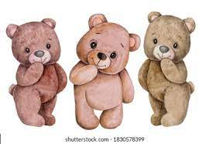
Personal, Social and Emotional Development (PSED)
Listen to stories and play with props to explore different feelings
Access high quality resources freely, without needing help
Choosing milk or water at snack time
Model useful phrases to take turns
Visiting new places in Stafford with our key workers
How this looks in the Explorers room at Parkside
Explore our bodies and objects around us, inside and outdoors
Kind hands and kind feet
Sharing family photographs
Showcasing examples of kindness and honesty
Modelling play to show expressions and gestures
Developing confidence to try new things
Sharing objects from our Special Box

Slide 13
Communication and Language
The development of children’s spoken language underpins all seven areas of learning and development. Children’s back‑and‑forth interactions from an early age form the foundations for language and cognitive development. The number and quality of the conversations they have with adults and peers throughout the day in a language-rich environment is crucial. By commenting on what children are interested in or doing, and echoing back what they say with new vocabulary added, practitioners will build children’s language effectively.
Reading frequently to children, and engaging them actively in stories, non-fiction, rhymes and poems, and then providing them with extensive opportunities to use and embed new words in a range of contexts, will give children the opportunity to thrive. Through conversation, storytelling and role play, where children share their ideas with support and modelling from their teacher, and sensitive questioning that invites them to elaborate, children become comfortable using a rich range of vocabulary and language structures.
 | Autumn | Spring | Summer
 | We are learning to… Make ourselves understood. Start to say how we are feeling, using words as well as actions. Start to develop conservation, often jumping from topic to topic. Develop pretend play. Understand single words in context. Understand frequently used words. Understand simple instructions. | We are learning to... Consolidation of previous skills taught. Use intonation, pitch and changing volume when 'talking'. Use the speech sounds: p, b, m, w and pronounce: l, r, w, y, f, th, s, sh, ch, dz, j and multi-syllabic words. | We are learning to... Consolidation of previous skills taught. Understand simple questions about 'who', 'what' and 'where'.
Observational Checkpoints | By around 2 years old, is the child showing an interest in what other children are playing and sometimes joins in? By around 3 years old, can the child shift from one task to another if you get their attention. Using the child’s name can help: “Jason, please can you stop now? We’re tidying up”. Towards their second birthday, can the child use up to 50 words? Is the child beginning to put two or three words together: “more milk”? Is the child frequently asking questions, such as the names of people and objects? Towards their third birthday, can the child use around 300 words? These words include descriptive language. They include words for time (for example, ‘now’ and ‘later’), space (for example, ‘over there’) and function (for example, they can tell you a sponge is for washing). Is the child linking up to 5 words together? Is the child using pronouns (‘me’, ‘him’, ‘she’), and using plurals and prepositions (‘in’, ‘on’, ‘under’) – these may not always be used correctly to start with. Can the child follow instructions with three key words like: “Can you wash dolly’s face?”

Slide 14
Communication and Language
Expressing our emotions using new vocabulary given to us by key workers
Morning and Afternoon greetings
Listening to music, watching performances of dance and songs
Time to think
Nursery Rhyme time
How this looks in the Explorers room at Parkside
Key workers introduce new words through our play
Phase 1 phonics (when appropriate)
Forest School: All 5 senses
Sharing picture books with adults
Listen and repeat the names of things modelled by key workers
Reply to questions and follow instructions
Chatty Snack time

Slide 15
Physical Development
Physical activity is vital in children’s all-round development, enabling them to pursue happy, healthy and active lives. Gross and fine motor experiences develop incrementally throughout early childhood, starting with sensory explorations and the development of a child’s strength, co-ordination and positional awareness through tummy time, crawling and play movement with both objects and adults.
By creating games and providing opportunities for play both indoors and outdoors, adults can support children to develop their core strength, stability, balance, spatial awareness, co-ordination and agility. Gross motor skills provide the foundation for developing healthy bodies and social and emotional well‑being. Fine motor control and precision helps with hand-eye co-ordination which is later linked to early literacy. Repeated and varied opportunities to explore and play with small world activities, puzzles, arts and crafts and the practice of using small tools, with feedback and support from adults, allow children to develop proficiency, control and confidence.
 | Autumn | Spring | Summer
 | We are learning to… Enjoy moving when outdoors and inside. Use large and small motor skills to do things independently, for example manage buttons and zips, and pour drinks. Develop manipulation and control. Clap and stomp to music. Start to kick, throw and catch balls. Build independently with a range of appropriate resources. Fit ourselves into spaces and move around in them. Spin and roll. Sit on a push-along wheeled toy. | We are learning to... Consolidation of previous skills. Start eating independently and learning how to use a knife and fork. Walk, run, jump and climb and start to use the stairs independently. Explore different materials and tools. Use a scooter. Independently use ropes and swings. | We are learning to... Consolidation of previous skills. Show an increasing desire to be independent, such as wanting to feed themselves and dress or undress. Ride a tricycle.
Observational Checkpoints | Around their second birthday, can the toddler run well, kick a ball, and jump with both feet off the ground at the same time? Around their third birthday, can the child climb confidently, catch a large ball and pedal a tricycle?

Slide 16
Physical Development
Use our fingers to tear different papers
Construction inside and outside
Using a potty and toilet safely
Inset puzzles and jigsaws
Make marks and print on a variety of papers
Tummy time
How this looks in the Explorers room at Parkside
Encouraging good eating habits: sharing and waiting for a second helping
Different sized implements and tools for building and mark making
Water and sand play
Encouraging independence when putting on coats and wellies
Parachute games
Playing with large and small equipment
Balance bikes
Listen and repeat the names of things modelled by key workers
Den building

Slide 17
Literacy
It is crucial for children to develop a life-long love of reading. Reading consists of two dimensions: language comprehension and word reading. Language comprehension (necessary for both reading and writing) starts from birth. It only develops when adults talk with children about the world around them and the books (stories and non‑fiction) they read with them, and enjoy rhymes, poems and songs together. Skilled word reading, taught later, involves both the speedy working out of the pronunciation of unfamiliar printed words (decoding) and the speedy recognition of familiar printed words. Writing involves transcription (spelling and handwriting) and composition (articulating ideas and structuring them in speech, before writing).
 | Autumn | Spring | Summer
 | We are learning to… Enjoy songs and rhymes, tuning in and paying attention. Join in with songs and rhymes, copying sounds, rhythms, tunes and tempo. Copy finger movements and gestures. Sing songs independently. Enjoy sharing books with an adult. Pay attention and respond to the pictures or the words. Have favourite books and seek them out, to share with an adult, with another child, or to look at alone. Enjoy drawing freely. Add some marks to our drawing which we give meaning to. | We are learning to... Consolidation of previous skills. Notice some print. Make marks on our pictures to stand for our name. | We are learning to... Consolidation of previous skills. Repeat words and phrases from familiar stories. Ask questions about books. Make comments and share our own ideas. Develop play around favourite stories using props.

Slide 18
Literacy
Daily story time
Everybody Writes immersive provision into story
Puppets and soft toys to retell stories to
Nursery Rhyme time
Bedtime stories
Staff modelling writing through play
How this looks in the Explorers room at Parkside
Explore our favourite stories through linked high-quality provision
Sensory mark making
Outdoor reading
Playground chalks
Using different resources to make marks
Forest School sticks for mark making
Engaging reading areas with familiar and new stories/books
Nursery rhyme sacks

Slide 19
Mathematics
Developing a strong grounding in number is essential so that all children develop the necessary building blocks to excel mathematically. Children should be able to count confidently, develop a deep understanding of the numbers to 10, the relationships between them and the patterns within those numbers.
By providing frequent and varied opportunities to build and apply this understanding – such as using manipulatives, including small pebbles and tens frames for organising counting – children will develop a secure base of knowledge and vocabulary from which mastery of mathematics is built. In addition, it is important that the curriculum includes rich opportunities for children to develop their spatial reasoning skills across all areas of mathematics including shape, space and measures. It is important that children develop positive attitudes and interests in mathematics, look for patterns and relationships, spot connections, ‘have a go’, talk to adults and peers about what they notice and not be afraid to make mistakes.
 | Autumn | Spring | Summer
 | We are learning to… Combine objects and put objects inside others and take them out again. Take part in finger rhymes with numbers. Develop counting like behaviour, such as making sounds, pointing or saying some numbers in sequence. Climb and squeeze ourselves into different types of spaces. Build with a range of resources. Complete inset puzzles. | We are learning to... Consolidation of previous skills. Count in everyday contexts, sometimes skipping numbers. React to changes of amount in a group of up to three items. Compare sizes, weights using gesture and language. | We are learning to... Consolidation of previous skills. Compare amounts saying ‘lots’, ‘more’ or ‘same’. Notice patterns and arrange things in patterns.

Slide 20
Mathematics
Daily Mental Maths counting songs
Inset puzzles
Numbers within provision, staff model early recognition
Water & sand play with different sized containers
Exploring interestingly shaped objects
How this looks in the Explorers room at Parkside
Different sized objects in provision
Singing finger rhymes
Modelling the language of size and weight in everyday contexts
Patterns within the environment
Repeated experiences of daily counting
Forest School collecting interesting objects to combine
Building inside and outdoors using different sized blocks
Staff describing children’s positions using spatial language

Slide 21
Understanding the world
Understanding the world involves guiding children to make sense of their physical world and their community. The frequency and range of children’s personal experiences increases their knowledge and sense of the world around them – from visiting parks, libraries and museums to meeting important members of society such as police officers, nurses and firefighters. In addition, listening to a broad selection of stories, non-fiction, rhymes and poems will foster their understanding of our culturally, socially, technologically and ecologically diverse world. As well as building important knowledge, this extends their familiarity with words that support understanding across domains. Enriching and widening children’s vocabulary will support later reading comprehension.
 | Autumn | Spring | Summer
 | We are learning to… Explore natural materials, indoors and outdoors. Make connections between the features of their family and other families. | We are learning to... Consolidation of previous skills. Explore materials with different properties. Explore and respond to different natural phenomena in their setting and on trips. | We are learning to... Consolidation of previous skills. Notice differences between people.

Slide 22
Understanding the world
Family photographs in our learning environment
Sensory play
Exploring real life objects
Forest School
Welly walks
Giant magnifying glasses
How this looks in the Explorers room at Parkside
Stories with images to reflect diversity of life in modern Britain
All weather school puddle suits
Parkside vegetable patch
Exploring our locality of Stafford
Treasure baskets of natural loose parts
Quilma the hedgehog visit
Staff point out similarities and differences between families
FaceTime a Farmer
Reindeer visitors

Slide 23
Expressive arts and design
The development of children’s artistic and cultural awareness supports their imagination and creativity. It is important that children have regular opportunities to engage with the arts, enabling them to explore and play with a wide range of media and materials. The quality and variety of what children see, hear and participate in is crucial for developing their understanding, self‑expression, vocabulary and ability to communicate through the arts. The frequency, repetition and depth of their experiences are fundamental to their progress in interpreting and appreciating what they hear, respond to and observe.
 | Autumn | Spring | Summer
 | We are learning to… Anticipate phrases and actions in rhymes and songs. Move and dance to music. Explore their voices and enjoy making sounds. Join in with songs and rhymes, making some sounds. Make rhythmical and repetitive sounds. Notice patterns with strong contrasts and be attracted by patterns resembling the human face. Explore paint, using fingers and other parts of their bodies as well as brushes and other tools. Enjoy and take part in action songs. Explore different materials, using all our senses to investigate them. Manipulate and play with different materials. | We are learning to... Consolidation of previous skills. Explore a range of sound makers and instruments and play them in different ways. Starts to make marks intentionally. Express ideas and feelings through making marks, and sometimes give a meaning to the marks they make. | We are learning to... Consolidation of previous skills. Start to develop pretend play, pretending that one object represents another. Use our imagination to consider what we can do with different materials. Make simple models which express our ideas.

Slide 24
Expressive arts and design
Painting with our bodies
Sensory play
Nativity performance
Collaborative EYFS displays to showcase learning
Daily Nursery rhyme time
Visit to the pantomime
How this looks in the Explorers room at Parkside
Musicians and performer visiting school
Songs to match routines
Building models with a variety of materials
Music wall
Quilma the hedgehog visit
Pattern, colour, tones and texture rich environment
Barefoot Walk
Messy play

Slide 25
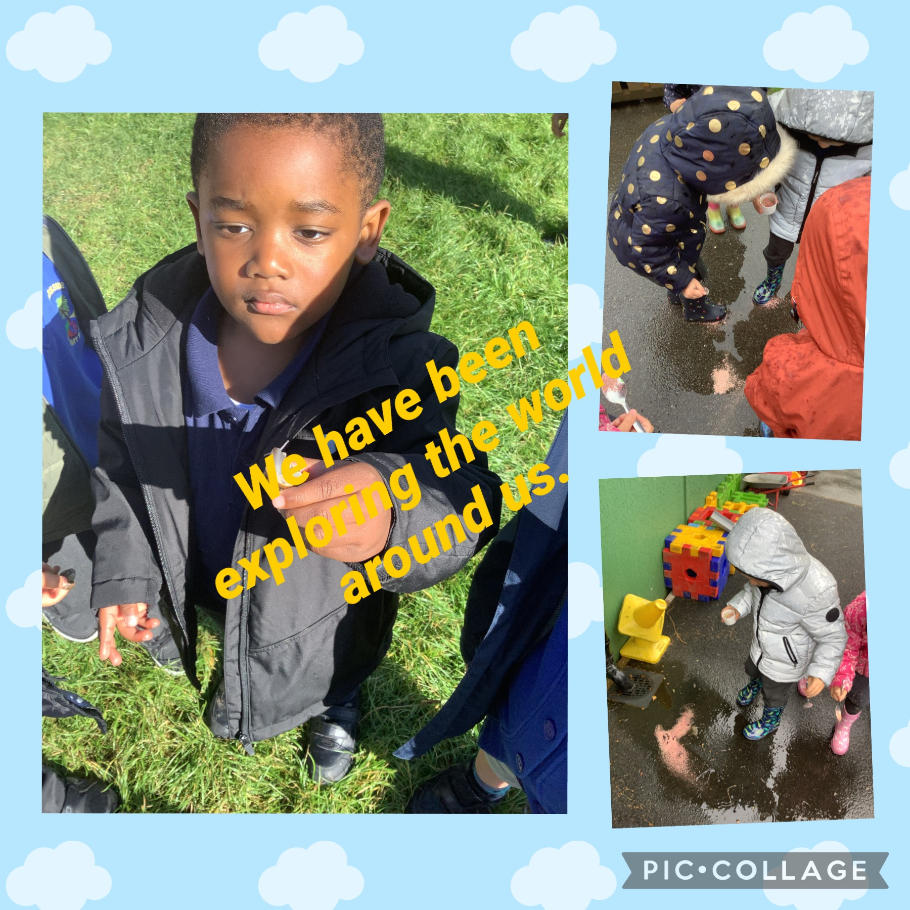
The Investigators’ Curriculum

Slide 26
The Investigators Termly Planner
 | Autumn | Spring | Summer
Launch Day & Celebration | Fantastic First Day at Preschool Nativity choir Harvest Craft & Songs Christmas Crafts | Easter Egg Hunt | Caterpillars arrival
Parental Contribution | Story Sacks Bedtime Stories Autumn treasures | Story boxes Nursery Rhyme packs Environmental Pledge | Stay and Play Graduation
Visits/Visitors | Quilma the Hedgehog Owl Festive Fun in the Forest Park Walk | Parkside Spring trail Lower Drayton Farm | Parkside Summer trail People Who Help Us
Celebrations | Autumn, Christmas traditions | Chinese New Year, Shrove Tuesday, Valentine’s Day, National Bee Day
Parkside Values | Kindness and Honesty | Pride and Determination | Respect and Independence
Forest School | Routines Bonfire Night bonfire | Investigating Winter & Spring Exploring our natural world | Investigating summer and new life
Key Vocabulary | Grandparents, grandad/pa, grandma/granny, acorn, pinecone, conker, Autumn, sunflower, woodland, celebrations, lights, festival, recycling | Winter, temperature, change, family, Earth, planet, home, house | Change, School, graduation, egg, hatch, grow,

Slide 27

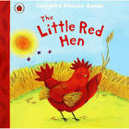


Autumn Term – All About Me / Autumn Celebrations
Personal, Social and Emotional Development
We will demonstrate an understanding of our school values of kindness and honesty in action. We will get to know our new classroom and school, following the rules and understand why they are in place. We will develop our independence to choose activities and resources in our classroom. We will develop our sense of belonging as part of the Parkside community. We will develop our confidence to become more outgoing with visitors in our classroom. We will play games and activities that enable us to play with more children. We will talk about our feelings using words to describe emotions. We will understand how our peers and key workers might be feeling through their modelling and discussion of emotions. We will independently use the toilet and wash our hands. We will make healthy choices at Chatty Snack.
Understanding the world
We will explore the natural world around us using our forest area. We will investigate natural materials such as: acorns, pinecones, conkers, sunflowers, woodland and use all our senses to explore. We will talk about what we can see in our forest area. We will meet a hedgehog and an owl to support our understanding of the world around us in our woodland. We will celebrate what makes us special and develop positive attitudes about the differences between people. We will begin to understand the need to respect and care for the natural environment through recycling.
Expressive arts and design
We use our role play area to develop our pretend play and will use objects to represent something else. We will use construction to create our own small worlds. We will use our independence to choose and explore different materials, knowing how we will use them. We will explore craft materials and textures and will join materials. We will create closed shapes with continuous lines and begin to use these shapes to represent objects. We will listen carefully to a variety of different sounds, inside and outside, responding to what we have heard. We will sing songs daily and will be able to sing these independently. We will play instruments with increasing control to express our feelings and ideas.
Communication and Language
We will enjoy listening to stories at story time. We will use the pictures to help us understand what is happening. When our key workers describe familiar objects we will identify them. We will use a wider range of vocabulary through newly introduced words and our language rich environment. Our key workers will ask us questions that have two pats and we will understand the question. We will sing a large repertoire of songs and know many rhymes. We will develop our love of books in our book area and will have a preference for a favourite book. We will start conversations with our key workers and peers during Chatty Snack.
Physical Development
We will use our outdoor area to continue to develop our movements. We will use the trikes and scooters to negotiate space. We will play games like musical statutes to encourage us to skip, hop, stand on one leg and hold a pose. We will use large muscle movements to wave flags and paint with large implements. We will collaborate with our friends to construct and move large items. We will use scissors and tweezers. Our key workers will encourage use to use a comfortable grip to increase our control when making marks. We will show a preference for a dominant hand. We will increase our independence when hanging up our belongings on our pegs and putting on our coats.
Literacy
We will listen to stories during our daily story time. We will participate in extended conversations about stories, using and applying new vocabulary that we have learnt. We will foster our love of reading by spending time in our book area and handling books correctly. We will develop our early writing to attempt to name our work and will use our print and letter knowledge in our early writing. We will write some familiar letters accurately. We will be exposed to a variety of environmental print in our classroom. We will take part in daily phonics lessons to develop our phonological awareness so that we can hear rhyme.
Mathematics
We will subitise to 3, recognising different representations. We will count daily and will sing number songs, helping us to recite numbers past 5. We will count out loose parts to say one number for each item in order: 1, 2, 3. We will know that the last number reached when counting a small set of objects tells you how many there are in total. We will use our fingers to show 3. We will see the numerals 1-3 in our provision. We will use our own symbols and marks to showcase our mathematical thinking. We will solve real world mathematical problems with numbers up to 3.

Slide 28



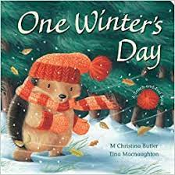




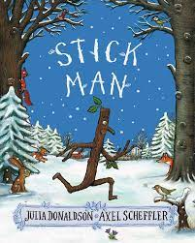
Spring Term – Me in Winter / Signs of Spring
Personal, Social and Emotional Development
We will demonstrate an understanding of our school values of pride and determination in action. We will play with one or more other children, extending and elaborating play ideas. We will be able to talk about who our friends are and know that some people are strangers. We will learn how to keep ourselves safe if we are around strangers. We will find solutions to conflicts and rivalries if they occur when we play with others. We will begin to remember our class rules without needing an adult to remind us.
Understanding the world
We will share photos from home that showcase our life and family. We will begin to make sense of our own life-story and family's history. We will understand what a home is and how these are different for different people. We will celebrate the festival Chinese New Year and Valentine’s Day. We will use our Forest School area to investigate the changes that take place in Winter and Spring. We will plant seeds and care for growing plants by watering them daily and providing them with sunlight. This will enable us to understand the key features of the life cycle of a plant; we will create a collaborative life cycle and will talk about the observations we make of our plants.
Mathematics
We will say one number for each item in order: 4 & 5. We will show ‘finger numbers’ up to 5. We will solve real world mathematical problems with numbers up to 5. We will learn to extend and create ABAB patterns. We will notice and correct an error in a repeating pattern. We will learn to compare quantities, up to 5, using language: ‘more than’, ‘fewer than’. We will talk about and explore 2D and 3D shapes. We will carefully select and use 3D shapes in our construction and will combine them to make new shapes. We will learn to make comparisons between objects relating to size, length, weight and capacity.
Physical Development
We will take part in daily dough gym to strengthen our fingers and develop our fine motor skills. We will develop our scissor skills by cutting different types of paper. We will use a variety of tools to make marks. We will start taking part in some group activities which we make up for ourselves, or in teams. We will choose the right resource to carry out a plan such as scissors for cutting. We will use large equipment outside, such as blocks and construction to develop our gross motor skills. We will develop our independence when getting our belongings, fastening our coats and putting on our wellies/shoes.
Literacy
We will take part in daily phonics teaching and learning. We will develop our phonological awareness so that we can identify environmental sounds and use our bodies as percussion. We will start to count or clap syllables in a word. We will make marks in cards to send to people who help us and Valentine’s cards. We will orally retell stories using Talk for Write and will sequence stories using pictures.
Expressive arts and design
We will notice and explore patterns on winter clothing. We will begin to develop our own stories using our story boxes. We will explore different materials to create art and will start to understand which materials work well together. We will develop our own ideas and then decide which materials will be best to express our ideas. We will use drawing to represent ideas like movement or loud noises. We will use paint to explore colour and colour mixing. We will show different emotions in painting and drawing. We will investigate different ways of mixing colours. We will sing the pitch of a tone sung by another person. We will join in with familiar songs and will sing the melodic shape. We will create our own songs and will improvise songs that are familiar to us.
Communication and Language
We will continue with our daily chatty snack in our key worker groups. We will understand 'why' questions, like "Why do you think the caterpillar got so fat?" We will listen to stories and will be able to tell a long story to someone else. We will learn many rhymes and will be able to talk about our favourite books. We will develop our pronunciation with the adults modelling standard spoken English. We will use longer sentences of four to six words when we share our news at the end of the day.

Slide 29


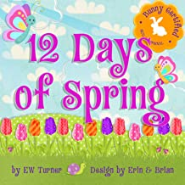





Summer Term – Watch Us Grow
Personal, Social and Emotional Development
We will demonstrate an understanding of our school values of respect and independence in action. We will be increasingly independent in our self-help skills and trying to solve conflicts through the use of language. We will be extending our play to include a wider group of friends. We will be buttering our own toast and pouring our own milk at the snack table.
Understanding the world
We will demonstrate an understanding of change in animals and nature. This will include looking at the differences between animals that hatch from eggs and animals that do not. We will look at how some animals look like their parents at birth and how some others do not such as caterpillars. We will have caterpillars in our classroom to observe their changes and growth. We will explore our own history in terms of how we are now 4/5 years old. We will explore our future history in terms of moving on to school. We may have siblings starting nursery and will be encouraged to recall how we were babies once. We will talk about moving on in terms of some friends who may not be coming to our school and the idea that there are other places with other schools. We will show interest in different occupations.
Mathematics
We will continue to make marks to represent numbers, and these will increasingly become more accurate. We will use our sand/ water to discuss and think about the language of capacity. Using our daily routine, we will be talking about the language of routine.
Physical Development
We will be writing our first name. We will all be able to put our coat and shoes on independently. We will be increasingly independent with our knife and fork skills. We will have a preference to a dominant hand. In our environment we will independent and able to organize ourselves for activities. We will begin to be able to take our jumpers on and off more independently.
Literacy
We will be able to write our Christian name and some other letters. We will use our mark making to help write shopping lists for nursery and sometimes order our own individual snack when at our snack cafe. We will be working towards understanding initial sounds. We will be broadening our use of vocabulary and how we build conversations with others. This will include explaining our opinions and predictions for stories.
Expressive arts and design
We will be drawing representations of ourselves that are increasingly accurate and show emotions on the faces. We will use our craft area to explore more junk modelling and understand how we can create something new by combining boxes / materials. We will be more confident with our colour mixing and notice it more in our exploration of craft. We will recall entire songs and perform them in small groups / or may even sing nursery rhymes on our own. We will act out familiar stories that we can recall from the year.
Communication and Language
We will be developing our skills to follow two part instructions. We will be able to continue conversations with adults and increasingly offer opinions on situations. We will extend our use of vocabulary in our play with others. We will be more confident and able to answer and respond to 'why' questions.

Slide 30
Personal, Social and Emotional Development (PSED)
Children’s personal, social and emotional development (PSED) is crucial for children to lead healthy and happy lives, and is fundamental to their cognitive development. Underpinning their personal development are the important attachments that shape their social world. Strong, warm and supportive relationships with adults enable children to learn how to understand their own feelings and those of others.
Children should be supported to manage emotions, develop a positive sense of self, set themselves simple goals, have confidence in their own abilities, to persist and wait for what they want and direct attention as necessary. Through adult modelling and guidance, they will learn how to look after their bodies, including healthy eating, and manage personal needs independently. Through supported interaction with other children they learn how to make good friendships, co-operate and resolve conflicts peaceably. These attributes will provide a secure platform from which children can achieve at school and in later life.
 | Autumn | Spring | Summer
Self-Regulation Managing Self Making Relationships | We are learning to… Get to know our new classroom and school. Select and use activities and resources, with help where needed. Develop our sense of responsibility and membership of a community. Become more outgoing with unfamiliar people, in the safe context of our setting. Show more confidence in new social situations. Play with one or more other children. Increasingly follow rules, understanding why they are important. Talk about our feelings using words like ‘happy’, ‘sad’, ‘angry’ or ‘worried’. Understand gradually how others might be feeling. Be increasingly independent in meeting our own care needs. Make healthy choices about food, drink, activity and toothbrushing. | We are learning to... Consolidation of previous skills taught. Play with one or more other children, extending and elaborating play ideas. Find solutions to conflicts and rivalries. Remember rules without needing and adult to remind us. | We are learning to... Consolidation of previous skills taught. Develop appropriate ways of being assertive. Talk with other to solve conflicts.
Observational Checkpoints | Around the age of 3 Can the child sometimes manage to share or take turns with others, with adult guidance and understanding ‘yours’ and ‘mine’? Can the child settle to some activities for a while? Around the age of 4 Does the child play alongside others or do they always want to play alone? Does the child take part in pretend play (for example, being ‘mummy’ or ‘daddy’?) Does the child take part in other pretend play with different roles – being the Gruffalo, for example? Can the child generally negotiate solutions to conflicts in their play? Note: watch out for children who seem worried, sad or angry for much of the time, children who seem to flit from one thing to the next or children who seem to stay for over-long periods doing the same thing, and become distressed if they are encouraged to do something different You will need to work closely with parents and other agencies to find out more about these developmental difficulties. Look out for children who appear to be overweight or to have poor dental health, where this has not been picked up and acted on at an earlier health check. Discuss this sensitively with parents and involve the child’s health visitor. Adapt activities to suit their particular needs, so all children feel confident to move and take part in physical play. Most, but not all, children are reliably dry during the day by the age of 4. Support children who are struggling with toilet training, in partnership with their parents. Seek medical advice, if necessary, from a health visitor or GP.

Slide 31

Personal, Social and Emotional Development (PSED)
Children as snack monitors
Accessing high quality resources freely, without needing help
Self-registration using photographs and Christian names
Exploring our local community of Stafford
Talk together about how characters are feeling
How this looks in The Investigators at Parkside
People Who Help Us visiting our setting
Staff model ways of calming themselves down
Peer support modelling positive relationships and actions
Staff model inviting children to participate in new activities
Weekly Champions Award
Collaborative creating role play areas
Real life and familiar role play
Praising examples of Kindness and Honesty

Slide 32
Communication and Language
The development of children’s spoken language underpins all seven areas of learning and development. Children’s back‑and‑forth interactions from an early age form the foundations for language and cognitive development. The number and quality of the conversations they have with adults and peers throughout the day in a language-rich environment is crucial. By commenting on what children are interested in or doing, and echoing back what they say with new vocabulary added, practitioners will build children’s language effectively.
Reading frequently to children, and engaging them actively in stories, non-fiction, rhymes and poems, and then providing them with extensive opportunities to use and embed new words in a range of contexts, will give children the opportunity to thrive. Through conversation, storytelling and role play, where children share their ideas with support and modelling from their teacher, and sensitive questioning that invites them to elaborate, children become comfortable using a rich range of vocabulary and language structures.
 | Autumn | Spring | Summer
 | We are learning to… Listen to simple stories and understand what is happening, with the help of the pictures. Identify familiar objects and properties for practitioners when they are described. Understand and act on longer sentences like ‘make teddy jump’ or ‘find your coat’. Use a wider range of vocabulary. Understand a question or instruction that has two parts. Sing a large repertoire of songs. Know many rhymes, be able to talk about familiar books. Develop communication but may continue to have problems with irregular tense and plurals. Start a conversation with an adult or a friend and continue it for many turns. | We are learning to.. Consolidation of previous skills taught. Understand 'why' questions, like "Why do you think the caterpillar got so fat?" Know many rhymes, be able to talk about familiar books, and be able to tell a long story. Develop our pronunciation but may have problems saying some sounds: r, j, th, ch, sh and multi-syllabic words. Use longer sentences of four to six words. | We are learning to... Consolidation of previous skills taught. Be able to express a point of view and to debate when we disagree with an adult or friend, using words as well as actions. Use talk to organise ourselves and our play.
Observational Checkpoints | Around the age of 3, can the child shift from one task to another if you fully obtain their attention, for example, by using their name? Around the age of 4, is the child using sentences of four to six words – “I want to play with cars” or “What’s that thing called?”? Can the child use sentences joined up with words like ‘because’, ‘or’, ‘and’? For example: “I like ice cream because it makes my tongue shiver”. Is the child using the future and past tense: “I am going to the park” and “I went to the shop”? Can the child answer simple ‘why’ questions?

Slide 33
Communication and Language
Enjoy listening to longer stories and remembering much of what happens
Annotations of children’s thoughts and ideas to learning walls
Active story time using imagination
Freely sharing books with others in the Reading Area
Nursery Rhyme time
How this looks in The Investigators at Parkside
Daily story time
Adults prompt with open ended questions
Sensory story telling
Adults modelling rich and subject specific language
Adults modelling correct grammar
Language rich environment
Investigating interesting objects to prompt discussions
Positive praise for use of language throughout the whole day
Chatty Snack time

Slide 34
Physical Development
Physical activity is vital in children’s all-round development, enabling them to pursue happy, healthy and active lives. Gross and fine motor experiences develop incrementally throughout early childhood, starting with sensory explorations and the development of a child’s strength, co-ordination and positional awareness through tummy time, crawling and play movement with both objects and adults.
By creating games and providing opportunities for play both indoors and outdoors, adults can support children to develop their core strength, stability, balance, spatial awareness, co-ordination and agility. Gross motor skills provide the foundation for developing healthy bodies and social and emotional well‑being. Fine motor control and precision helps with hand-eye co-ordination which is later linked to early literacy. Repeated and varied opportunities to explore and play with small world activities, puzzles, arts and crafts and the practice of using small tools, with feedback and support from adults, allow children to develop proficiency, control and confidence.
 | Autumn | Spring | Summer
 | We are learning to… Continue to develop our movement, balancing, riding and ball skills. Skip, hop, stand on one leg and hold a pose for a game like musical statues. Use large-muscle movements to wave flags and streamers, paint and make marks. Start taking part in some group activities. Collaborate with others to manage large items. Use one-handed tools and equipment. Use a comfortable grip with good control when holding pens and pencils. Show a preference for a dominant hand. Be increasingly independent as we get dressed and undressed. | We are learning to... Consolidation of previous skills taught. Start taking part in some group activities which they make up for themselves, or in teams. Match our developing physical skills to tasks and activities in the setting. Choose the right resource to carry out a plan. | We are learning to... Consolidation of previous skills taught. Go up steps and stairs, or climb up apparatus, using alternate feet. Increasingly be able to use and remember sequences and patterns of movements which are related to music and rhythm.

Slide 35
Physical Development
Use of small one-handed tools: scissors, tweezers
Balance bikes
Staff encouraging self-help and encouraging trying new things
Construction Area
Write Dance & Dough Disco
Encouraging independence using knives and forks
How this looks in The Investigators at Parkside
Weekly PE slot in the hall
Threading
Encouraging independence with hygiene and toileting
Building towers using large and small construction
Parachute team games
Dancing songs, action songs and games
Use of the school field
Encouraging independence when putting on our wellies and coats
Dancing

Slide 36
Literacy
It is crucial for children to develop a life-long love of reading. Reading consists of two dimensions: language comprehension and word reading. Language comprehension (necessary for both reading and writing) starts from birth. It only develops when adults talk with children about the world around them and the books (stories and non‑fiction) they read with them, and enjoy rhymes, poems and songs together. Skilled word reading, taught later, involves both the speedy working out of the pronunciation of unfamiliar printed words (decoding) and the speedy recognition of familiar printed words. Writing involves transcription (spelling and handwriting) and composition (articulating ideas and structuring them in speech, before writing).
 | Autumn | Spring | Summer
 | We are learning to… Engage in extended conversations about stories, learning new vocabulary. Use some of our print and letter knowledge in our early writing. Write some of our name. Write some letters accurately. Understand the five key concepts about print: print has meaning, print can have different purposes, we read English text from left to right from top to bottom, the names of different parts of a book, page sequencing. Develop our phonological awareness so that we can spot and suggest rhymes. | We are learning to... Consolidation of previous skills taught. Develop our phonological awareness so that we can count or clap syllables in a word. Write some letters accurately. | We are learning to... Consolidation of previous skills taught. Develop our phonological awareness so that we can recognise words with the same initial sound, such as money and mother. Write all of our name.

Slide 37
Literacy
Everybody Writes immersive provision into story
Recognising our Christian names, self-registration
Drama and role play
Active stories using props and our imaginations
Nursery Rhyme time
Character in role and dressing up
How this looks in The Investigators at Parkside
Daily Phonics
Story tray with props to retell
Staff modelling language to retell stories and describe events/characters
Reading familiar and favourite stories
Staff asking questions to facilitate comprehension
Language rich environment
Library visits and library books to take home
Nursery rhyme sacks

Slide 38
Mathematics
Developing a strong grounding in number is essential so that all children develop the necessary building blocks to excel mathematically. Children should be able to count confidently, develop a deep understanding of the numbers to 10, the relationships between them and the patterns within those numbers.
By providing frequent and varied opportunities to build and apply this understanding – such as using manipulatives, including small pebbles and tens frames for organising counting – children will develop a secure base of knowledge and vocabulary from which mastery of mathematics is built. In addition, it is important that the curriculum includes rich opportunities for children to develop their spatial reasoning skills across all areas of mathematics including shape, space and measures. It is important that children develop positive attitudes and interests in mathematics, look for patterns and relationships, spot connections, ‘have a go’, talk to adults and peers about what they notice and not be afraid to make mistakes.
 | Autumn | Spring | Summer
 | We are learning to… Develop fast recognition of up to 3 objects, without having to count them individually (subitising). Recite numbers past 5. Say one number for each item in order: 1, 2, 3. Know that the last number reached when counting a small set of objects tells you how many there are in total. Show ‘finger numbers’ up to 3. Link numerals and amounts. Experiment with our own symbols and marks as well as numerals. Solve real world mathematical problems with numbers up to 3. | We are learning to... Consolidation of previous skills taught. Say one number for each item in order: 4 & 5. Show ‘finger numbers’ up to 5. Solve real world mathematical problems with numbers up to 5. Extend and create ABAB patterns. Notice and correct an error in a repeating pattern. Compare quantities using language: ‘more than’, ‘fewer than’. Talk about and explore 2D and 3D shapes. Make comparisons between objects relating to size, length, weight and capacity. Select shapes appropriately. Combine shapes to make new ones. | We are learning to... Consolidation of previous skills taught. Understand position through words alone. Describe a familiar route. Discuss routes and locations, using words like ‘in front of’ and ‘behind’. Begin to describe a sequence of events, real or fictional using words such as 'first', 'then'.

Slide 39
Mathematics
Number of the week
Number rich environment
Spotting numbers in real life
Forest School: spotting patterns and comparing natural objects
Shapes in toast
Staff discussing age and birthdays
How this looks in The Investigators at Parkside
Daily mental maths
Staff modelling mathematical language
Immersive number focus in learning environment
Mathematical mark making
Staff modelling counting throughout daily routines
Patterns in the environment, ourselves and objects
Sand/water play
Counting songs and rhymes

Slide 40
Understanding the world
Understanding the world involves guiding children to make sense of their physical world and their community. The frequency and range of children’s personal experiences increases their knowledge and sense of the world around them – from visiting parks, libraries and museums to meeting important members of society such as police officers, nurses and firefighters. In addition, listening to a broad selection of stories, non-fiction, rhymes and poems will foster their understanding of our culturally, socially, technologically and ecologically diverse world. As well as building important knowledge, this extends their familiarity with words that support understanding across domains. Enriching and widening children’s vocabulary will support later reading comprehension.
 | Autumn | Spring | Summer
 | We are learning to… Use all of our sense in hands-on exploration of natural materials. Explore collections of materials with similar and/or different properties. Talk about what we see, using a wide vocabulary. Show interest in different occupations. Continue to develop positive attitude about the differences between people. | We are learning to... Consolidation of previous skills taught. Plant seeds and care for growing plants. Understand the key features of the life cycle of a plant. Begin to understand the need to respect and care for the natural environment and all living things. Know that there are different countries in the world and talk about the differences they have experienced or seen in photos. Begin to make sense of their own life-story and family's history. | We are learning to... Consolidation of previous skills taught. Understand the key features of a life cycle of an animal. Explore and talk about different forces we can feel. Explore how things work. Talk about the differences between materials and changes we notice.

Slide 41
Understanding the world
Frogspawn experience
Investigation of natural materials using magnifying glasses. Staff model observational skills and language
Messy play
Baking and cooking
Natural objects play
Caterpillar experience
Forest School
How this looks in The Investigators at Parkside
Exploring programmable toys
All weather school puddle suits
Weather stations, collecting leaves, collecting rain water
Parkside vegetable patch
Family photographs and sharing of memories and occupations
Quilma the hedgehog visit
Inviting interesting occupations to visit and talk about their jobs
Exploration of mechanical toys
Reindeer visitors

Slide 42
Expressive arts and design
The development of children’s artistic and cultural awareness supports their imagination and creativity. It is important that children have regular opportunities to engage with the arts, enabling them to explore and play with a wide range of media and materials. The quality and variety of what children see, hear and participate in is crucial for developing their understanding, self‑expression, vocabulary and ability to communicate through the arts. The frequency, repetition and depth of their experiences are fundamental to their progress in interpreting and appreciating what they hear, respond to and observe.
 | Autumn | Spring | Summer
 | We are learning to… Take part in simple pretend play, using an object to represent something else even though they are not similar. Make imaginative and complex ‘small worlds’ with blocks and construction kits, such as a city with different buildings and a park. Explore different materials freely, to develop our ideas about how to use them and what to make. Develop our own ideas and then decide which materials to use to express them. Join different materials and explore different textures. Create closed shapes with continuous lines and begin to use these shapes to represent objects. Explore colour and colour mixing. Listen with increased attention to sounds. Respond to what we have heard, expressing our thoughts and feelings. Remember and sing entire songs. Play instruments with increasing control to express our feelings and ideas. | We are learning to... Consolidation of previous skills taught. Use drawing to represent ideas like movement or loud noises. Show different emotions in painting. Sing the pitch of a tone sung by another person. Sing the melodic shape of familiar songs. Create our own songs or improvise a song around one we know. | We are learning to... Consolidation of previous skills taught. Draw with increasing complexity and detail, such as representing a face with a circle and including details. Show different emotions in our drawings.

Slide 43
Expressive arts and design
Listening to a range of musical instruments
Special day celebrations
Freely able to draw indoors and outdoors
Making cards for celebrations
Daily Nursery rhyme time
Making our own paintbrushes using natural objects
How this looks in The Investigators at Parkside
Body percussion
Role play area
Story telling
Listening to a variety of music and creating movements to match
Drama
Adults modelling imaginative play
Dancing
Performing our own nativity
Artist focus to work in the style of

Slide 44
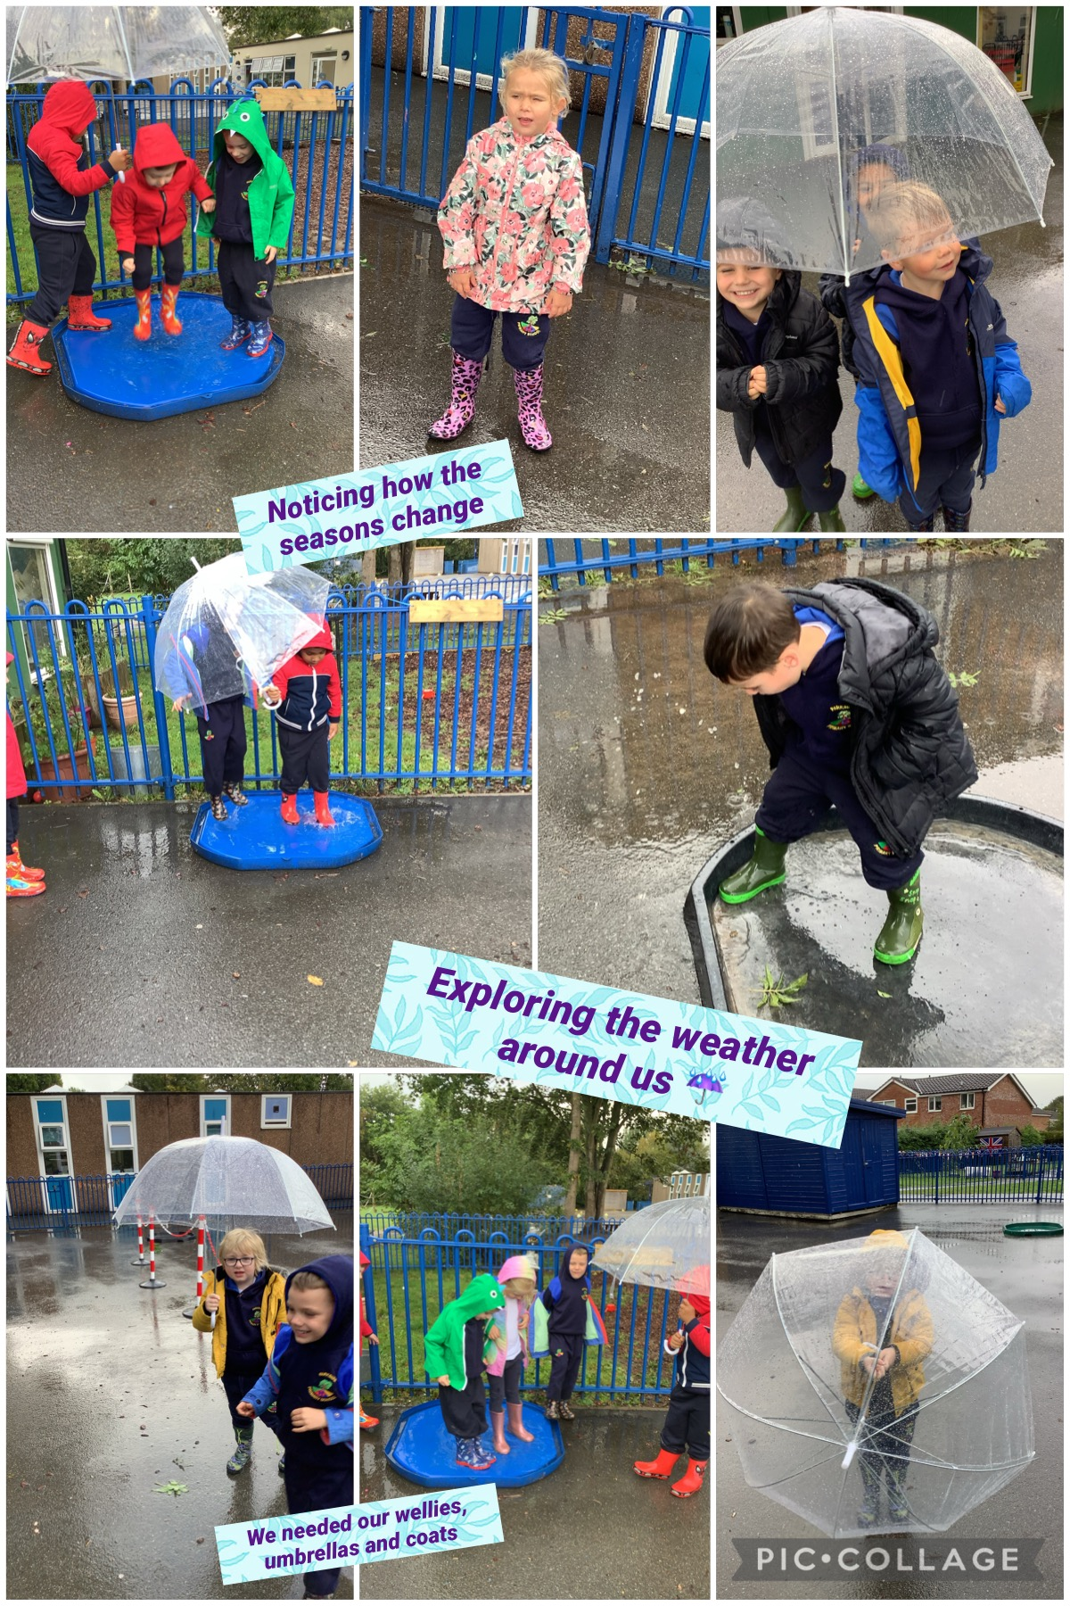
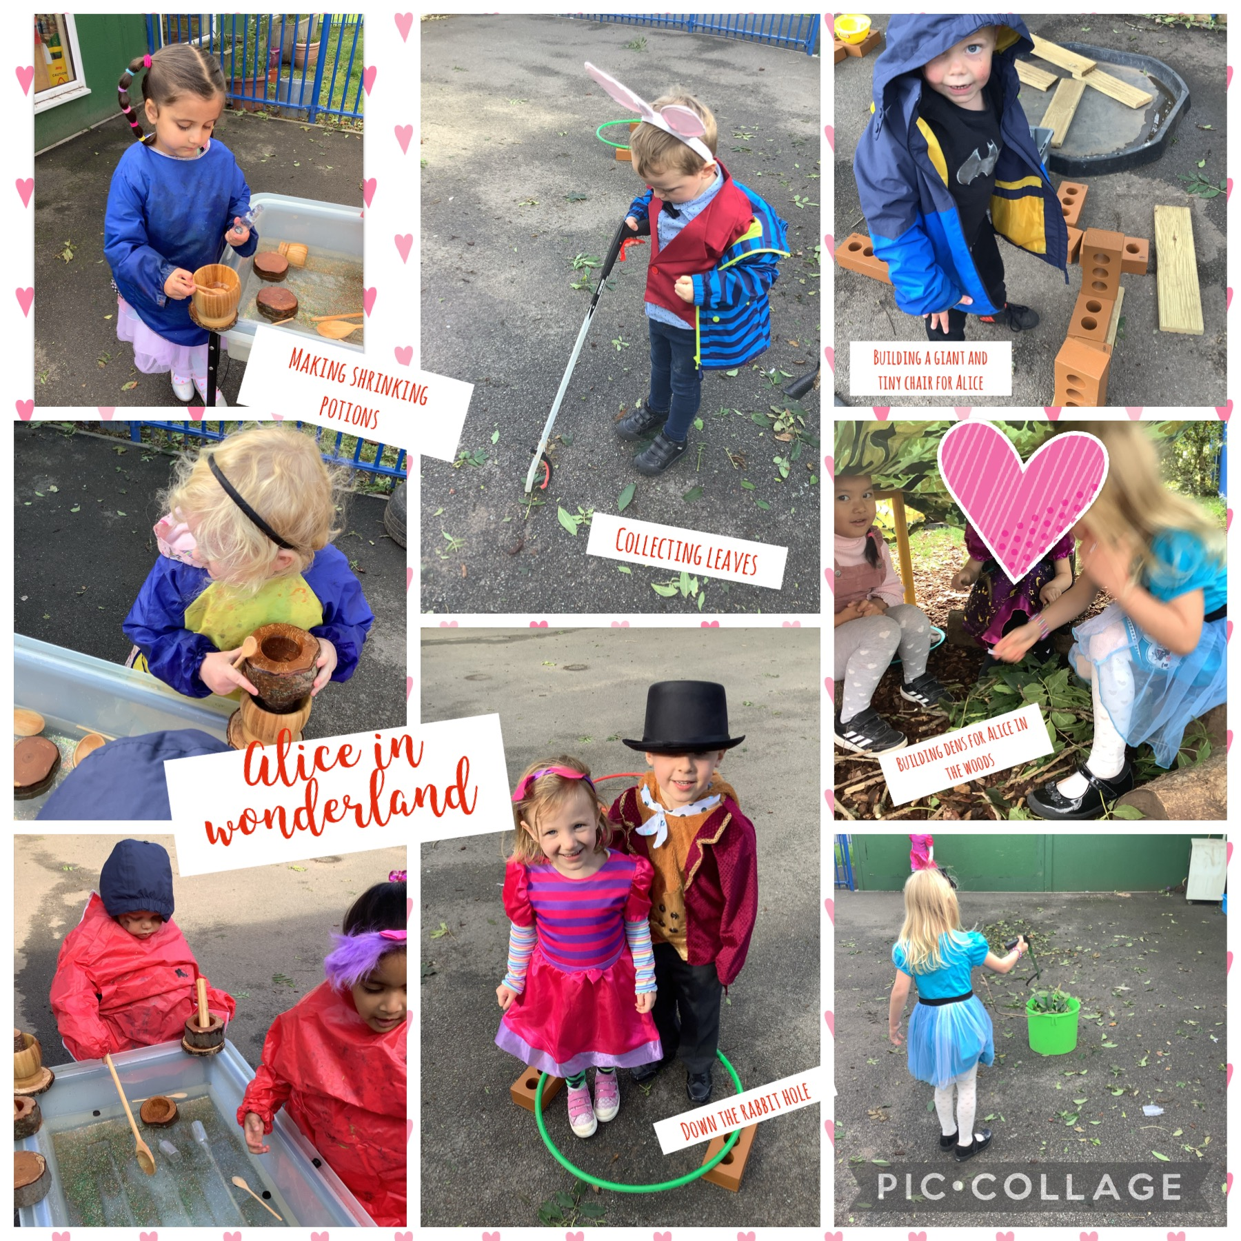
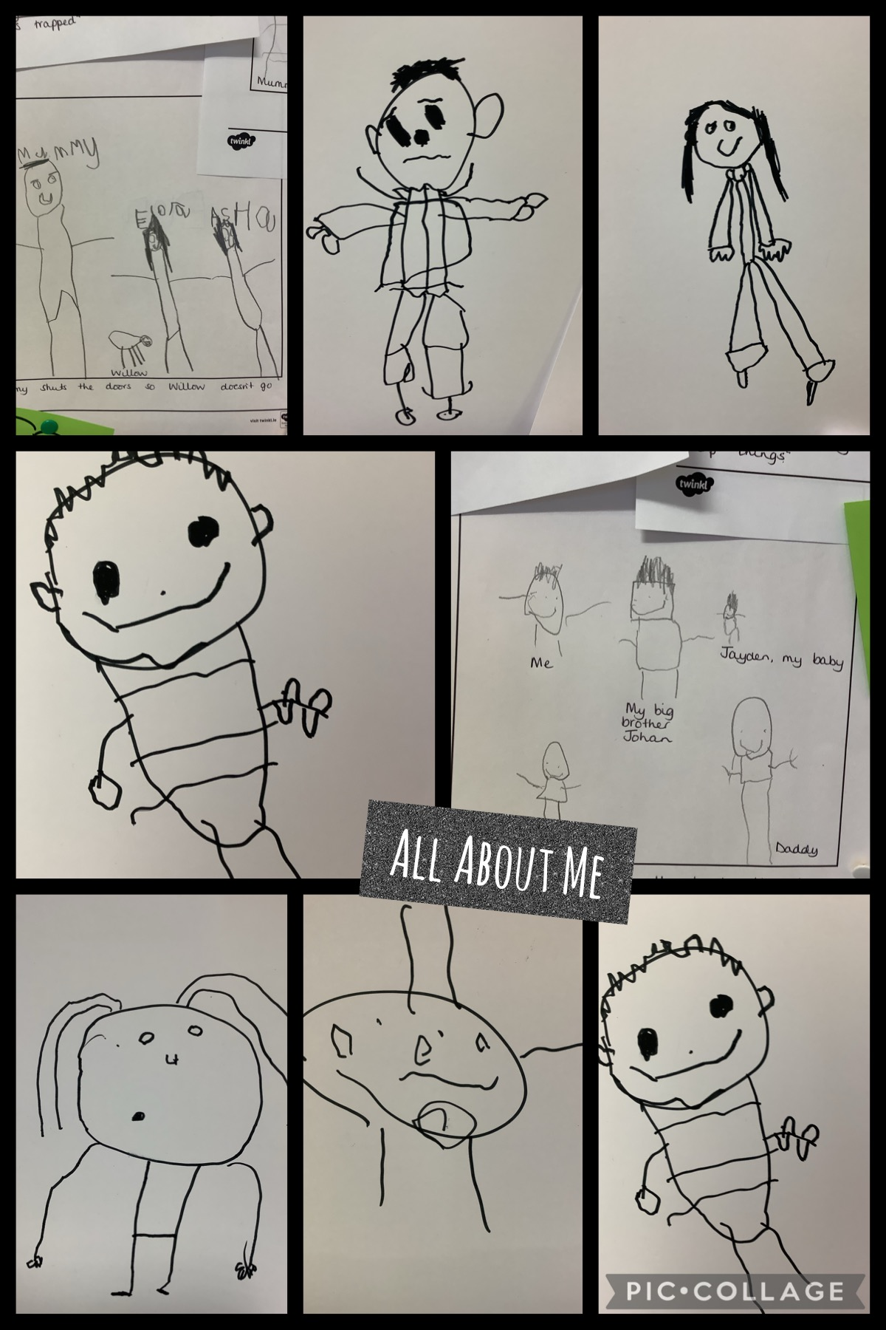
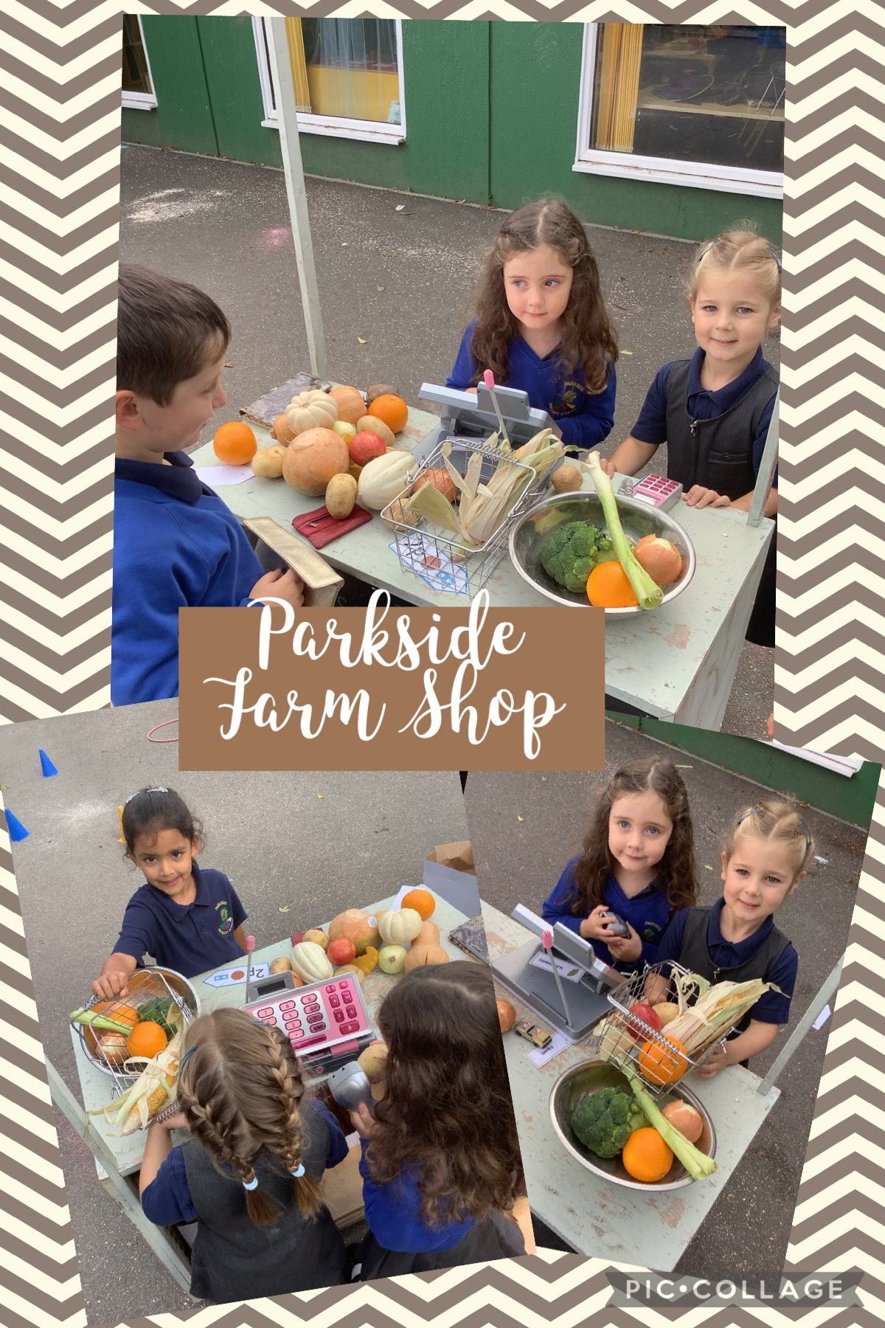
The Rangers’ Curriculum

Slide 45
The Rangers Termly Planner
 | Autumn | Spring | Summer
Launch Day & Celebration | Wonderful first week Nativity speaking roles My First Day photo | World Adventurers Parkside aeroplane experience | Fairy Tale Ball
Parental Contribution | Bedtime stories Autumn scavenger hunt | School garden planters Parkside Spring trail | Family photographs from holidays in the past Parkside Summer trail
Visits/Visitors | Nocturnal and diurnal animals Festive Fun in the Forest | Living Eggs, Peak Wildlife Park, Pilot, Cabin crew, Visiting Church at Easter | Islamic visitors into school
Celebrations | Harvest, Bonfire Night, Autumn, Remembrance Day, Diwali, Christmas | New Year, Chinese New Year, Mother's Day, Holi Festival, Easter | Eid al-Fitr, Ramadan
Parkside Values | Kindness and Honesty | Pride and Determination | Respect and Independence
Forest School | Rules, routines, independence. Building bonfires, bird feeders | Landscaping and creating a school garden, springwatch | Building Shelters Forest School with Mr Sutton
Key Vocabulary | Respect, similar, different, natural, nocturnal, diurnal, hibernation, habitat, celebration, season | Change, bravery, exploration, country, continent, climate, travel, transport, life cycle, tradition, celebration, culture, sowing, planting | Traditional tale, fairytale, mini-beast, ocean, creature, change, past, History

Slide 46
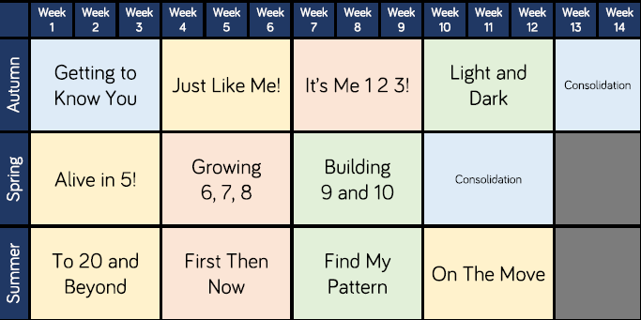
White Rose Maths Yearly Overview

Slide 47
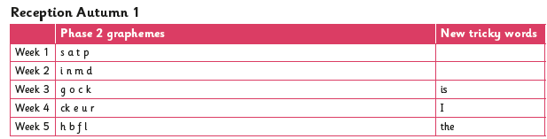
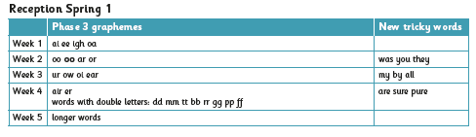
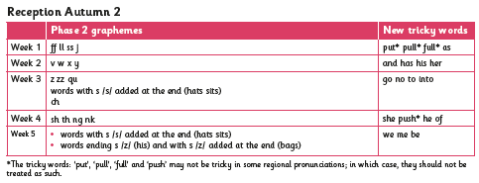
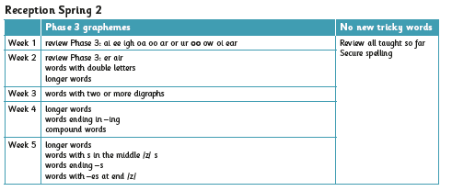
Little Wandle Phonics Overview: Autumn and Spring

Slide 48
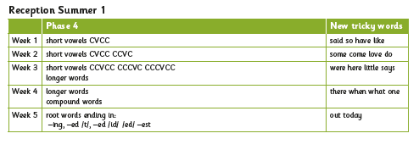
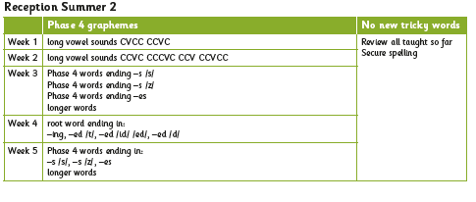
Little Wandle Phonics Overview: Summer

Slide 49



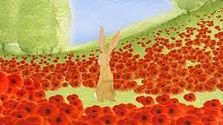
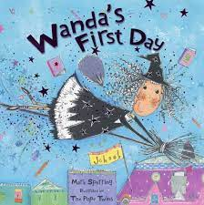
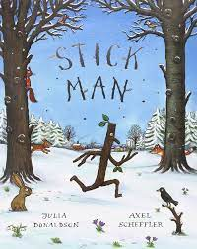
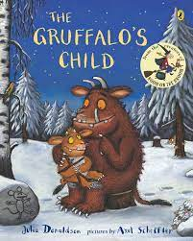
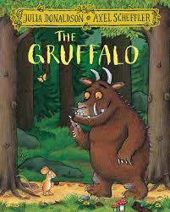
Autumn Term – Let’s Celebrate
Personal, Social and Emotional Development
We will demonstrate an understanding of our school values of kindness and honesty in action. We will explain our understanding of these values and how we use them in our daily lives. We will celebrate what makes us special and unique, understanding that we are all valuable individuals. We will make new friendships, respecting our peers. We will express the way we feel and will consider the feelings of others. We will consider the perspective of others and our friends might be made to feel. We will use the toilet independently and will wash our hands to promote good hand hygiene.
Understanding the world
We will create family trees to show the members of our immediate family. We will name and describe people in our school and community who are familiar to us. We will learn about characters from the past such as Guy Fawkes and Rama and Sita. We will learn about the significance of Remembrance Day and why people wear a poppy. We will celebrate the festivals of Harvest, Diwali and Christmas, recognising that people have different beliefs and celebrate special times in different ways. We will understand that some places are special to members of our community. We will explore and investigate our forest area, describing what we see, hear and feel through the changing seasons. We will learn about woodland animals, understanding about their habitats. We will learn about nocturnal and diurnal animals and will meet both types of animal to embed our learning.
Expressive arts and design
We will explore, use and refine a variety of artistic effects to express our ideas and feelings. We will learn to create observational drawings of sunflowers, The Gruffalo, poppies and poinsettias. We will learn about the artist Jackson Pollock and will create artwork in his style. We will return to and build on our previous learning, refining ideas and developing our ability to represent them. We will use junk modelling to create collaboratively, sharing ideas, resources and skills. We will listen attentively, move to and talk about music, expressing our feelings and responses. We will watch and talk about dance and performance art, expressing our feelings and responses. We will learn Nativity songs and will sing in a group, matching the pitch and following the melody. We will use the story props and ‘mini me’ to develop storylines in our pretend play.
Physical Development
We will use our outdoor area to revise and refine the fundamental movement skills we have already acquired. We will use large apparatus, alone and in a group. We will develop our overall body-strength, balance, co-ordination and agility. We will progress towards a more fluent style of moving. We will use our core muscle strength to sit with good posture on the carpet and at a table. We will combine movements with fluency and ease when completing our daily Just Dance activities. We will use small tools in the classroom with accuracy. We will develop the foundations of a handwriting style which is fast, accurate and efficient. We will line up and queue for lunchtimes and when moving into the main school building.
Literacy
We will use the Little Wandle phonics scheme to develop our phonics knowledge in order to become fluent and independent readers. We will read books that are matched to our phonics knowledge. We will re-read these books to build up our confidence in word reading, our fluency and our understanding and enjoyment. We will use our phonics to help us spell words using our phonics knowledge to write the letter or letters needed. We will write for a purpose to create labels, lists and captions. We will write our Christian name. We will form lower-case and capital letters correctly. We will spell words by identifying the sounds then writing the letter/s.
Communication and Language
We will know the importance of listening well. We will learn new vocabulary and will use this in our discussions and at Chatty Snack. We will ask questions to find our more and to check our understanding. We will use well-formed sentences to articulate our ideas and thoughts. We will use social phrases throughout the school day. We will engage in daily story time; listening to and talking about stories to build familiarity. We will retell stories using our own words, story language and words directly from the text. We will listen carefully to rhymes and songs, paying attention to how they sound. We will learn rhymes, poems and songs and perform in front of an audience. Our book area will enable us to engage in non-fiction books. We will listen to and talk about selected non-fiction to develop a deep familiarity with new knowledge and vocabulary.
Mathematics
We will count objects, actions and sounds. We will say the date daily, noting the day, month and year. We do mental maths daily to practice our counting and instant recall facts. We will subitise to 5 using different representations. We will link the number symbol (numeral) with its cardinal number value. We will count daily, beyond ten. We will compare numbers 1-5. We will understand the 'one more than/one less than' relationship between consecutive numbers 1-5. We will explore the composition of numbers 1-5 using loose parts and numicon to show different compositions. We will select, rotate and manipulate shapes to develop spatial reasoning skills. We will make and break shapes so that we understand shapes have other shapes within them.

Slide 50
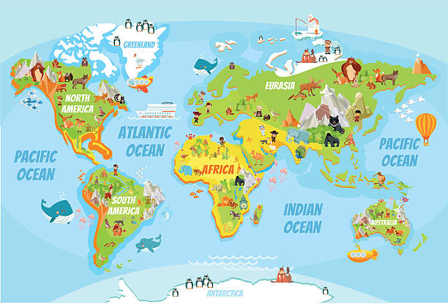


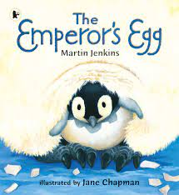





Spring Term – Around the world in just one term / Changes & Growth
Personal, Social and Emotional Development
We will demonstrate an understanding of our school values of pride and determination in action. We will show resilience and perseverance in the face of challenge. We will be able to recognise our own feelings and moderate these socially and emotionally. We will learn about ways of living a healthy lifestyle. We will study the Jigsaw units: Dreams & Goals, Healthy Me, My Health. We will revisit these themes daily through our PSED and Reflection Time.
Understanding the world
We will talk about events and celebrations that are happening in our lives, families and communities such as New Year, Chinese New Year, Mother's Day, Holi Festival, and Easter. We will learn about different countries in the world: United Kingdom, Antarctica and Africa. We will recognise some similarities and differences between in these countries and our lives in Stafford. We will understand that some places in the world are different to where we live in Stafford. We will explore different representations of maps and will draw our own simple information maps. We will create our own simple maps. We will understand that some places are special to members of our community and will visit these places. We recognise that people have different beliefs and celebrate special times in different ways. We will visit church at Easter to understand why and how Christians celebrate Easter. We will use our Forest School area to describe what we see, hear and feel in Winter and Spring. We will investigate the effects of winter and spring on the natural world around us. We will work collaboratively with our parents to create a school garden and grow our own plants.
Mathematics
We will continue to explore the composition of numbers to 10, extended our knowledge to 6, 7, 8, 9 & 10. We will use loose part, numicon and numerals to show different representations of the numbers. We will continue to embed our fluency in subitizing to 5. We will be able to automatically recall number bonds for numbers 0-5 and some to 10 using number rhymes, songs and actions to help us. We will compare length, weight and capacity.
Physical Development
We will consolidate and refine the fundamental movement skills we have already acquired: rolling, crawling, skipping, hopping, running. We will develop our overall body strength, co-ordination and agility so that we are able to engage successfully with future physical education sessions and other physical disciplines including dance, gymnastics, sport and swimming. We will continue to complete our daily Just Dance sessions, following and copying a routine. We will
develop our small motor skills so that we can use a range of tools competently, safely and confidently including developing our independence when using a knife and fork at lunchtime. We will further develop and refine a range of ball skills such as underarm throwing and catching with two hands.
Literacy
We will use the Little Wandle phonics scheme to develop our phonics knowledge in order to become fluent and independent readers. We will read books that are matched to our phonics knowledge. We will use our phonics to help us spell words using our phonics knowledge to write the letter or letters needed. We will write for a purpose to create labels, lists and captions. We will write short phrases and sentences with words with known sound-letter correspondences using a capital letter and full stop. We will write recognisable letters, forming most correctly using print. We will show our understanding of books that have been read to us by retelling stories and narratives using our own words and new vocabulary. We will discuss new vocabulary that we have learnt and will use this to retell stories. We will predict what might happen next in a story. We will describe characters, thinking about their appearance, feelings and emotions.
Expressive arts and design
We will create collaboratively to make props for our role play area. We will explore, use and refine a variety of artistic effects such as painting and observational drawings to express our ideas and feelings. We will consolidate our colour mixing skills independently. We will apply our knowledge of the artist Jackson Pollock into our independent artwork. We will learn how to use watercolour paints to create a watercolour wash. We will learn and perform songs for Easter. We will continue to learn and perform Just Dance routines. We will learn about joining techniques and consider which method is most effective to use. We will learn about the artist Caroline Shotton and will create artwork in her style.
Communication and Language
We will continue with our daily Chatty Snack sessions, facilitated by adults but led by children’s interests. We will communicate our thoughts, ideas and actions to another using a range of connectives when discussing our knowledge and understanding. We will use stories to help us describe events in some detail using our own words and new vocabulary that we have learnt. We will use talking partners to help us work our problems and organise thinking and activities, and to explain how things work and why they might happen. We will have a deep knowledge and understanding of stories enabling us to retell, using some repetition from the story and some of our own words.

Slide 51

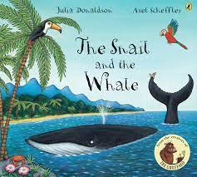



Summer Term – Happily Ever After / The Deep Blue Sea
Personal, Social and Emotional Development
We will demonstrate an understanding of our school values of respect and independence in action. We will know and talk about the different factors that support our overall health and wellbeing. We will learn how to be a safe pedestrian, by crossing the road safely and role playing this on our playground using a track and bikes. We will learn how to stay safe in the sun, how to apply sun cream and why this is important. We will know to have sensible amounts of screen time. We will talk about the importance of having a good sleep routine. We will study the Jigsaw units: Relationships and My Body. We will revisit these themes daily through our PSED and Reflection Time.
Understanding the world
We will share photographs of family holidays in the past. We will talk about members of our family and how they enjoyed their summer holidays. We will continue to describe what we see, hear and feel whilst outside in the Summer. We will understand the effect of the changing seasons on the natural world around us and will be able to identify signs of Summer. We will learn about, and celebrate, the festivals of Eid al-Fitr and Ramadan, understanding how people celebrate special times in different ways. We will learn the skills required to build a bug hotel in the Forest School area. We will work with Mr Sutton to complete a Forest School block to further develop our Forest School skills and prepare us for Forest School in Year 1.
Mathematics
We will count beyond 20. We will begin to notice patterns in the counting system, beyond 20. We will recall number bonds to 10 and recall some related subtraction facts. We will share amounts. We will name odd and even numbers. We will recall double facts to 10. We will continue to develop our spatial reasoning through manipulating shapes.
Physical Development
We will revise and refine the fundamental movement skills we have already acquired: running and climbing. We will continue to challenge ourselves and take risks in our Outdoor Area using large equipment to embed the physical skills we have acquired. We will further develop and refine a range of ball skills including using different sized balls, throwing and catching. We will develop our athletic skills ready for Sports Day. We will continue to learn to hold a pencil effectively so that our handwriting styles are efficient.
Literacy
We will use the Little Wandle phonics scheme to develop our phonics knowledge in order to become fluent and independent readers. We will read books that are matched to our phonics knowledge. We will learn to write short sentences containing words with known sound-letter correspondences using a capital letter and full stop. We will re-read what we have written to check that it makes sense. We will write retells of stories that we are familiar with, including some of the story language we have embedded. We will write for a purpose including: fact files, lists and story retellings. We will learn to predict events within stories.
Communication and Language
We will continue with our daily Chatty Snack sessions, facilitated by adults but led by children’s interests. We will continue to develop our retelling of stories, with confidence, using our embedded vocabulary and story language. We will listen carefully to rhymes and songs, paying attention to how they sound.
Expressive arts and design
We will listen attentively, move to and talk about music, expressing our feelings and responses. We will explore and engage in music making and dance, performing solo or in groups. We will learn about the artist Georgia O’Keeffe and will create art in her style. We will learn how to smudge using oil pastels.

Slide 52
Personal, Social and Emotional Development (PSED)
Children’s personal, social and emotional development (PSED) is crucial for children to lead healthy and happy lives, and is fundamental to their cognitive development. Underpinning their personal development are the important attachments that shape their social world. Strong, warm and supportive relationships with adults enable children to learn how to understand their own feelings and those of others.
Children should be supported to manage emotions, develop a positive sense of self, set themselves simple goals, have confidence in their own abilities, to persist and wait for what they want and direct attention as necessary. Through adult modelling and guidance, they will learn how to look after their bodies, including healthy eating, and manage personal needs independently. Through supported interaction with other children they learn how to make good friendships, co-operate and resolve conflicts peaceably. These attributes will provide a secure platform from which children can achieve at school and in later life.
 | Autumn | Spring | Summer
Self-Regulation Managing Self Making Relationships | We are learning to… See ourselves as a valuable individual. Build constructive and respectful relationships. Express our feelings and consider the feelings of others. Think about the perspective of others. Manage our own personal hygiene needs. | We are learning to... Show resilience and perseverance in the face of challenge. Identify and moderate our own feelings socially and emotionally. Know and talk about the different factors that support our overall health and wellbeing: Healthy eating, regular physical activity, toothbrushing. | We are learning to... Know and talk about the different factors that support our overall health and wellbeing: being a safe pedestrian, staying safe in the sun, sensible amounts of screen time, having a good sleep routine.
Observational Checkpoints: Early Learning Goal Children at the expected level of development will: | Self-Regulation Show an understanding of their own feelings and those of others, and begin to regulate their behaviour accordingly; Set and work towards simple goals, being able to wait for what they want and control their immediate impulses when appropriate; Give focused attention to what the teacher says, responding appropriately even when engaged in activity, and show an ability to follow instructions involving several ideas or actions. Managing Self Be confident to try new activities and show independence, resilience and perseverance in the face of challenge; Explain the reasons for rules, know right from wrong and try to behave accordingly; Manage their own basic hygiene and personal needs, including dressing, going to the toilet and understanding the importance of healthy food choices. Building Relationships Children at the expected level of development will: Work and play cooperatively and take turns with others; Form positive attachments to adults and friendships with peers; Show sensitivity to their own and to others’ needs.

Slide 53

Personal, Social and Emotional Development (PSED)
Champion Assembly award
Modelling good manners and morning greetings
Child initiated play
Parkside Values
Mindfulness exercises
How this looks in The Rangers at Parkside
Children taking responsibility as monitors
Year 6 Buddy friendships
Calming down strategies
Embedded hygiene routines
Clear rules to keep us safe when accessing risk in play
The Colour Monster story emotions
Circle Times
Forest School: Resilience, Emotional wellbeing

Slide 54
Communication and Language
The development of children’s spoken language underpins all seven areas of learning and development. Children’s back‑and‑forth interactions from an early age form the foundations for language and cognitive development. The number and quality of the conversations they have with adults and peers throughout the day in a language-rich environment is crucial. By commenting on what children are interested in or doing, and echoing back what they say with new vocabulary added, practitioners will build children’s language effectively.
Reading frequently to children, and engaging them actively in stories, non-fiction, rhymes and poems, and then providing them with extensive opportunities to use and embed new words in a range of contexts, will give children the opportunity to thrive. Through conversation, storytelling and role play, where children share their ideas with support and modelling from their teacher, and sensitive questioning that invites them to elaborate, children become comfortable using a rich range of vocabulary and language structures.
 | Autumn | Spring | Summer
 | We are learning to… Understand how to listen carefully and why listening is important. Learn new vocabulary. Use new vocabulary throughout the day. Ask questions to find our more and to check that we understand what has been said to us. Articulate our ideas and thoughts in well-formed sentences. Develop social phrases. Engage in storytimes. Listen to and talk about stories to build familiarity. Retell the story, once we have developed a deep familiarity with the text, some exact repetition and some in our own words. Use new vocabulary in different contexts. Listen carefully to rhymes and songs, paying attention to how they sound. Learn rhymes, poems and songs. Engage in non-fiction books. Listen to and talk about selected non-fiction to develop a deep familiarity with new knowledge and vocabulary. | We are learning to... Connect one idea or action to another using a range of connectives. Describe events in some detail. Use talk to help work our problems and organise thinking and activities, and to explain how things work and why they might happen. Retell a story, once we have developed a deep familiarity with the text, some as exact repetition and some in their own words. | We are learning to... Retell a story, once we have developed a deep familiarity with the text, some as exact repetition and some in their own words. Listen carefully to rhymes and songs, paying attention to how they sound.
Observational Checkpoints: Early Learning Goal Children at the expected level of development will: | Listening, Attention and Understanding Listen attentively and respond to what they hear with relevant questions, comments and actions when being read to and during whole class discussions and small group interactions; Make comments about what they have heard and ask questions to clarify their understanding; Hold conversation when engaged in back-and-forth exchanges with their teacher and peers. Speaking Participate in small group, class and one-to-one discussions, offering their own ideas, using recently introduced vocabulary; Offer explanations for why things might happen, making use of recently introduced vocabulary from stories, non-fiction, rhymes and poems when appropriate; Express their ideas and feelings about their experiences using full sentences, including use of past, present and future tenses and making use of conjunctions, with modelling and support from their teacher.

Slide 55
Communication and Language
Chatty Snack
Language rich environment
Narrative immersion into high quality texts
Daily story time
Story trays, opportunities to retell stories using own words and language directly from text
How this looks in The Rangers classroom at Parkside
Reading opportunities indoors and outdoors
Adults model and support conversation skills
Reading familiar stories to build on knowledge and fluency
Literacy learning wall: working and progressive
Morning Greetings songs and routines
Decodable reading books: Dandelion
Key and new vocabulary on all learning walls
Talk for Writing

Slide 56
Physical Development
Physical activity is vital in children’s all-round development, enabling them to pursue happy, healthy and active lives. Gross and fine motor experiences develop incrementally throughout early childhood, starting with sensory explorations and the development of a child’s strength, co-ordination and positional awareness through tummy time, crawling and play movement with both objects and adults.
By creating games and providing opportunities for play both indoors and outdoors, adults can support children to develop their core strength, stability, balance, spatial awareness, co-ordination and agility. Gross motor skills provide the foundation for developing healthy bodies and social and emotional well‑being. Fine motor control and precision helps with hand-eye co-ordination which is later linked to early literacy. Repeated and varied opportunities to explore and play with small world activities, puzzles, arts and crafts and the practice of using small tools, with feedback and support from adults, allow children to develop proficiency, control and confidence.
 | Autumn | Spring | Summer
 | We are learning to… Revise and refine the fundamental movement skills we have already acquired: walking & jumping. Progress towards a more fluent style of moving, with developing control and grace. Use our core muscle strength to achieve a good posture when sitting at a table or sitting on the floor. Combine different movements with ease and fluency. Confidently and safely use a range of large and small apparatus indoors and outdoors, alone and in a group. Develop overall body-strength, balance, co-ordination and agility. Develop the foundations of a handwriting style which is fast, accurate and efficient. Further develop the skills we need to manage the school day successfully: lining up and queuing and lunchtimes. | We are learning to... Revise and refine the fundamental movement skills we have already acquired: rolling, crawling, skipping, hopping, running. Develop the overall body strength, co-ordination and agility needed to engage successfully with future physical education sessions and other physical disciplines including dance, gymnastics, sport and swimming. Develop our small motor skills so that we can use a range of tools competently, safely and confidently. Further develop and refine a range of ball skills. | We are learning to... Revise and refine the fundamental movement skills we have already acquired: running and climbing. Further develop and refine a range of ball skills.
Observational Checkpoints: Early Learning Goal Children at the expected level of development will: | Gross Motor Skills Negotiate space and obstacles safely, with consideration for themselves and others; Demonstrate strength, balance and coordination when playing; Move energetically, such as running, jumping, dancing, hopping, skipping and climbing. Fine Motor Skills Hold a pencil effectively in preparation for fluent writing – using the tripod grip in almost all cases; Use a range of small tools, including scissors, paint brushes and cutlery; Begin to show accuracy and care when drawing.

Slide 57
Physical Development
Track activities
Builders Yard
Collaborating with the kitchen about healthy foods
Getting changed independently
Forest School
Using large, small and real construction materials
How this looks in The Rangers at Parkside
Weekly PE sessions indoors and outdoors accessing small and large apparatus
Promoting good oral hygiene
A visit from a dentist
Bikes
Modelling and support for one handed tools
Daily Just Dance
Writing implements available indoors and outdoors
Making healthy lunchboxes
Snack time: healthy snacks

Slide 58
Literacy
It is crucial for children to develop a life-long love of reading. Reading consists of two dimensions: language comprehension and word reading. Language comprehension (necessary for both reading and writing) starts from birth. It only develops when adults talk with children about the world around them and the books (stories and non‑fiction) they read with them, and enjoy rhymes, poems and songs together. Skilled word reading, taught later, involves both the speedy working out of the pronunciation of unfamiliar printed words (decoding) and the speedy recognition of familiar printed words. Writing involves transcription (spelling and handwriting) and composition (articulating ideas and structuring them in speech, before writing).
 | Autumn | Spring | Summer
 | We are learning to… Read individual letters by saying the sounds for them. Blend sounds into words, so that we can read short words made up of known letter-sound correspondences. Read some letter groups that each represent one sound and say sounds for them. Read a few common exception words matched to our school's phonic programme. Read simple phrases and sentences made up of words with known letter-sound correspondences and, where necessary, a few common exception words. Re-read these books to build up our confidence in word reading, our fluency and our understanding and enjoyment. Form lower-case and capital letters correctly. Spell words by identifying the sounds and then writing the sound with letter/s. | We are learning to... Write short sentences with words with known sound-letter correspondences using a capital letter and full stop. | We are learning to... Write short sentences with words with known sound-letter correspondences using a capital letter and full stop. Re-read what we have written to check that it makes sense.
Observational Checkpoints: Early Learning Goal Children at the expected level of development will: | Comprehension Demonstrate understanding of what has been read to them by retelling stories and narratives using their own words and recently introduced vocabulary; Anticipate – where appropriate – key events in stories; Use and understand recently introduced vocabulary during discussions about stories, non-fiction, rhymes and poems and during role-play. Word Reading Say a sound for each letter in the alphabet and at least 10 digraphs; Read words consistent with their phonic knowledge by sound-blending; Read aloud simple sentences and books that are consistent with their phonic knowledge, including some common exception words. Writing Write recognisable letters, most of which are correctly formed; Spell words by identifying sounds in them and representing the sounds with a letter or letters; Write simple phrases and sentences that can be read by others.

Slide 59
Literacy
Reading books to encourage pupils as fluent and secure readers
Little Wandle: Letters and Sounds revised daily
Everybody Writes immersive provision into story
High quality text stimulus
Parent Watch Me Learn session
Clipboards, different papers, envelopes, post its within provision
Reading Area inside and outdoors
How this looks in The Rangers classroom at Parkside
Story trays to retell stories and create own
Phonics learning wall: working and progressive
Purposeful independent writing
Regular changing of books in Book Area. Familiar stories
Language rich environment
Phonic parent workshop
Adults modelling writing within provision: lists, instructions, stories, drawing, scribing
Decodable books: Dandelion Readers
High quality books in basket

Slide 60
Mathematics
Developing a strong grounding in number is essential so that all children develop the necessary building blocks to excel mathematically. Children should be able to count confidently, develop a deep understanding of the numbers to 10, the relationships between them and the patterns within those numbers.
By providing frequent and varied opportunities to build and apply this understanding – such as using manipulatives, including small pebbles and tens frames for organising counting – children will develop a secure base of knowledge and vocabulary from which mastery of mathematics is built. In addition, it is important that the curriculum includes rich opportunities for children to develop their spatial reasoning skills across all areas of mathematics including shape, space and measures. It is important that children develop positive attitudes and interests in mathematics, look for patterns and relationships, spot connections, ‘have a go’, talk to adults and peers about what they notice and not be afraid to make mistakes.
 | Autumn | Spring | Summer
 | We are learning to… Count objects, actions and sounds. Subitise. Link the number symbol (numeral) with its cardinal number value. Count beyond ten. Compare numbers. Understand the 'one more than/one less than' relationship between consecutive numbers. Explore the composition of numbers to 10. Select, rotate and manipulate shapes to develop spatial reasoning skills. Compose and decompose shapes so that children recognise a shape can have other shapes within it, just as numbers can. | We are learning to… Compare numbers. Explore the composition of numbers to 10. Automatically recall number bonds for numbers 0-5 and some to 10. Compare length, weight and capacity. | We are learning to... Verbally count beyond 20. Recognise pattern of the counting system beyond 20. Develop our spatial reasoning skills. Automatically recall double facts. Compare quantities up to 10 in different contexts by adding more and taking away.
Observational Checkpoints: Early Learning Goal Children at the expected level of development will: | Number Have a deep understanding of number to 10, including the composition of each number; Subitise (recognise quantities without counting) up to 5; Automatically recall (without reference to rhymes, counting or other aids) number bonds up to 5 (including subtraction facts) and some number bonds to 10, including double facts. Numerical Patterns Verbally count beyond 20, recognising the pattern of the counting system; Compare quantities up to 10 in different contexts, recognising when one quantity is greater than, less than or the same as the other quantity; Explore and represent patterns within numbers up to 10, including evens and odds, double facts and how quantities can be distributed equally.

Slide 61
Mathematics
Daily Mental Maths focus
Parent 'Stay and Solve' session
Active Maths
Number rich environment
Number songs and rhymes
Adults modelling mathematical language, discussion and problem solving
How this looks in The Rangers classroom at Parkside
Counting and number skills modelled daily
Opportunities to explore and investigate patterns
Purposeful tidying up linked to number of the week
Numicon indoors and giant numicon outdoors
White Rose planning
Pattern spotting in the environment
Tens frames for children wanting milk and fruit
Real life maths problem solving

Slide 62
Understanding the world
Understanding the world involves guiding children to make sense of their physical world and their community. The frequency and range of children’s personal experiences increases their knowledge and sense of the world around them – from visiting parks, libraries and museums to meeting important members of society such as police officers, nurses and firefighters. In addition, listening to a broad selection of stories, non-fiction, rhymes and poems will foster their understanding of our culturally, socially, technologically and ecologically diverse world. As well as building important knowledge, this extends their familiarity with words that support understanding across domains. Enriching and widening children’s vocabulary will support later reading comprehension.
 | Autumn | Spring | Summer
 | We are learning to… Talk about members of our immediate family and community. Name and describe people who are familiar to us. Compare and contrast characters from stories, including figures from the past. Understand that some places are special to members of our community. Recognise that people have different beliefs and celebrate special times in different ways. Describe what we see, hear and feel whilst outside. Understand the effect of the changing seasons on the natural world around us. | We are learning to... Draw simple information from a map. Recognise some similarities and differences between life in this country and life in other countries. Recognise some environments that are different to the one in which they live. Understand that some places are special to members of our community. Recognise that people have different beliefs and celebrate special times in different ways. Describe what we see, hear and feel whilst outside. Understand the effect of the changing seasons on the natural world around us. | We are learning to... Comment on images of familiar situations in the past. Talk about members of our immediate family and community. Describe what we see, hear and feel whilst outside. Understand the effect of the changing seasons on the natural world around us.
Observational Checkpoints: Early Learning Goal Children at the expected level of development will: | Past and Present Talk about the lives of the people around them and their roles in society; Know some similarities and differences between things in the past and now, drawing on their experiences and what has been read in class; Understand the past through settings, characters and events encountered in books read in class and storytelling. People, Culture and Communities Describe their immediate environment using knowledge from observation, discussion, stories, non-fiction texts and maps; Know some similarities and differences between different religious and cultural communities in this country, drawing on their experiences and what has been read in class; Explain some similarities and differences between life in this country and life in other countries, drawing on knowledge from stories, non-fiction texts and – when appropriate – maps. The Natural World Explore the natural world around them, making observations and drawing pictures of animals and plants; Know some similarities and differences between the natural world around them and contrasting environments, drawing on their experiences and what has been read in class; Understand some important processes and changes in the natural world around them, including the seasons and changing states of matter.

Slide 63
Understanding the world
Forest School
Fish pets
Living Eggs
Opportunities for awe and wonder
Progressive atlas and maps
Den Building
How this looks in The Rangers classroom at Parkside
Non-fiction books
Experimenting with processes and change
Exploring interesting natural objects
Visits from professionals within our local community
Staff modelling asking questions to find out more and explore
Visiting local places of worship
Celebrating times that are special to our class
Celebrating festivals from around the world

Slide 64
Expressive arts and design
The development of children’s artistic and cultural awareness supports their imagination and creativity. It is important that children have regular opportunities to engage with the arts, enabling them to explore and play with a wide range of media and materials. The quality and variety of what children see, hear and participate in is crucial for developing their understanding, self‑expression, vocabulary and ability to communicate through the arts. The frequency, repetition and depth of their experiences are fundamental to their progress in interpreting and appreciating what they hear, respond to and observe.
 | Autumn | Spring | Summer
 | We are learning to… Explore, use and refine a variety of artistic effects to express our ideas and feelings. Return to and build on our previous learning, refining ideas and developing our ability to represent them. Create collaboratively, sharing ideas, resources and skills. Listen attentively, move to and talk about music, expressing our feelings and responses. Watch and talk about dance and performance art, expressing our feelings and responses. Sing in a group, or on our own, increasingly matching the pitch and following the melody. Develop storylines in our pretend play. Explore and engage in music making and dance, performing solo or in groups. | We are learning to... Explore, use and refine a variety of artistic effects to express our ideas and feelings. Return to and build on our previous learning, refining ideas and developing our ability to represent them. Create collaboratively, sharing ideas, resources and skills. Develop storylines in our pretend play. Explore and engage in music making and dance, performing solo or in groups. | We are learning to... Listen attentively, move to and talk about music, expressing our feelings and responses. Explore and engage in music making and dance, performing solo or in groups.
Observational Checkpoints: Early Learning Goal Children at the expected level of development will: | Creating with Materials Safely use and explore a variety of materials, tools and techniques, experimenting with colour, design, texture, form and function; Share their creations, explaining the process they have used; Make use of props and materials when role playing characters in narratives and stories. Being Imaginative and Expressive Invent, adapt and recount narratives and stories with peers and their teacher; Sing a range of well-known nursery rhymes and songs; Perform songs, rhymes, poems and stories with others, and – when appropriate – try to move in time with music.

Slide 65
Expressive arts and design
Nativity: Speaking roles and singing
Artist focus and inspiration
Artists showcasing their work in school
Pantomime performance
Daily Just Dance
Imaginative play
How this looks in The Rangers classroom at Parkside
Retelling stories using props and costumes
High-quality role play area
Dressing up
Creating with a variety of materials
Independent application of artistic skills
Listening to a variety of music: recorded and live
Charanga music scheme
Exploring different medias

Slide 66

Proud to be Parkside
Concept: Colour Area of Learning: Expressive Arts & Design
The Explorers | The Investigators | The Rangers
Exploring paint Noticing patterns Naming primary colours | Exploring colour in the environment Colour mixing primary colours to make secondary colours Colours for emotions | Using colour effectively Independent mixing of colours to create a desired colour Mixing colours to create new shades

Slide 67
Proud to be Parkside
Concept: Animals Area of Learning: Understanding the World
The Explorers/ Adventurers | The Investigators | The Rangers
Seeing animals Naming animals Recognising patterns Making animal sounds | Exploring animals Naming animals and their babies Naming simple habitats Noticing changes Sequencing life cycles | Animals and their habitats Adaptations to habitats Nocturnal and diurnal animals

Slide 68
Proud to be Parkside
Concept: Celebrations Area of Learning: Understanding the World
The Explorers/ Adventurers | The Investigators | The Rangers
Colours Joining in with a party Gifting Wearing party clothes | Meeting people who celebrate Holding a celebration Celebrating special times | Recognising different beliefs Visiting a place of worship Similarities and differences Making links Investigating artefacts

Slide 69
Proud to be Parkside
Concept: Growth Area of Learning: Understanding the World
The Explorers/ Adventurers | The Investigators | The Rangers
Explore the natural world Plant seeds Noticing changes in ourselves and others | Plant and care for seeds Life Cycle of a plant Caring for animals Our height | Observing changes in a plant Sequencing life cycles for plants and animals Growing own plants from seeds Noticing similarities and differences amongst our peers

Slide 70
Proud to be Parkside
Concept: Seasons Area of Learning: Understanding the World
The Explorers/ Adventurers | The Investigators | The Rangers
Welly walks outdoors Bonfire Experience Collecting natural objects to make treasure baskets Noticing and naming colours | Sensory exploration of outdoors Weather Stations: Collecting leaves and rainwater Naming days of the week | Naming months of the year and Seasons Noticing and explaining changes Suggesting reasons for change 'Season Watch'

Slide 71
Proud to be Parkside
Concept: Ourselves Area of Learning: Understanding the World / Expressive Arts and Design
The Explorers/ Adventurers | The Investigators | The Rangers
Looking at ourselves in mirrors Naming our immediate family members Photos of ourselves and families | Writing Christian name Naming members of our extended family Painting a self portrait | Drawing line self-portraits using mirrors Writing full name Creating a family tree People in school who are familiar to us

