Slide 1
Changing Me
1. Life cycles in nature 2. Growing from old to young 3. The Changing Me 4. Boys' and girls' bodies 5. Assertiveness 6. Looking ahead

Slide 2
Life cycles in nature
Seasons - unable to control
Discussion - changes we can't control
Vocabulary Change, grow, life cycle, control, baby, adult, fully grown.

Slide 3
Growing from young to old
Change is a natural process, no control
Share photo's baby and now/relatives
What do children love about older relatives?
Vocabulary growing up, old, young, change, respect, appearance, physical

Slide 4
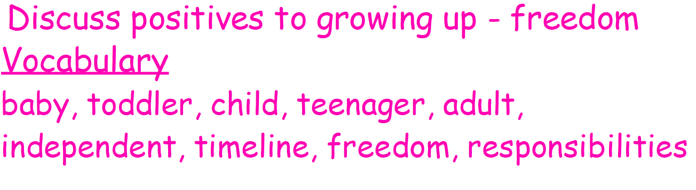
The Changing Me
Items in a bag - baby bottle, pencil, passport, car keys,

Slide 5
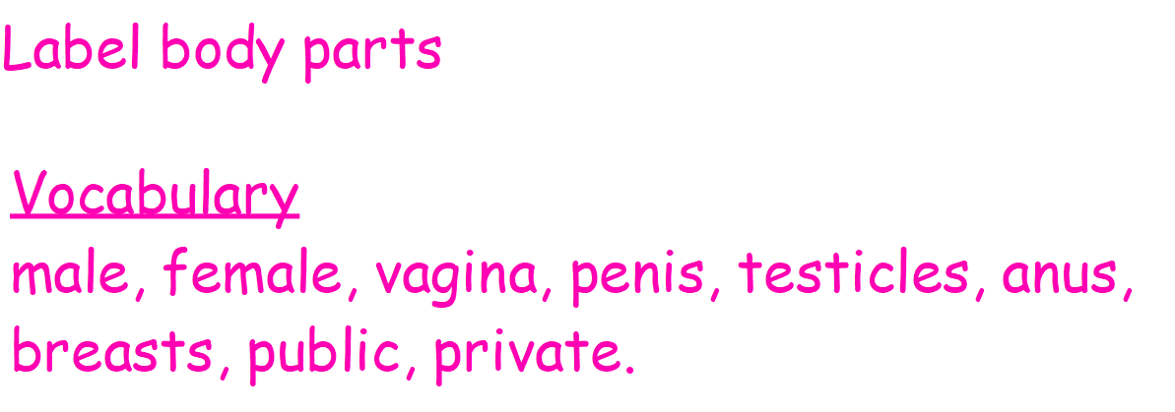
Boys' and girls' bodies

Slide 6
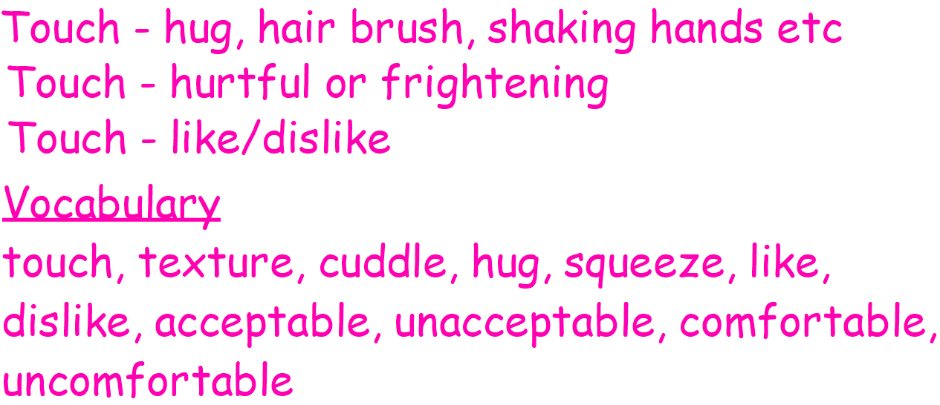
Assertiveness

Slide 7
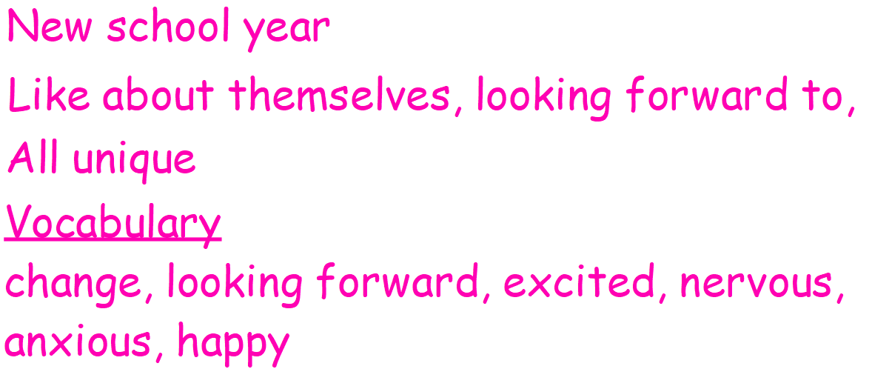
Looking ahead

