Slide 1

SRE in Year 3
Parkside Primary School

Slide 2
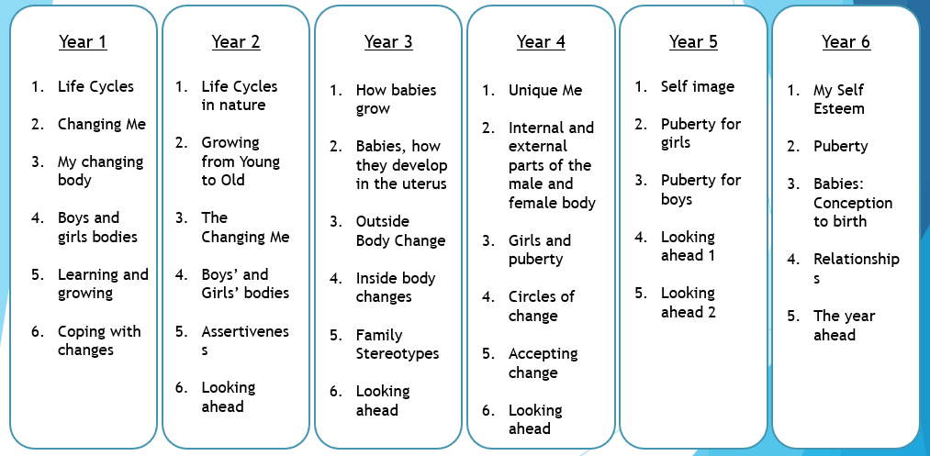
Progression of SRE at Parkside Primary School

Slide 3
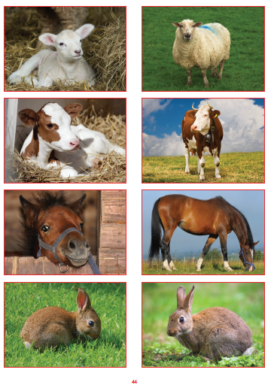
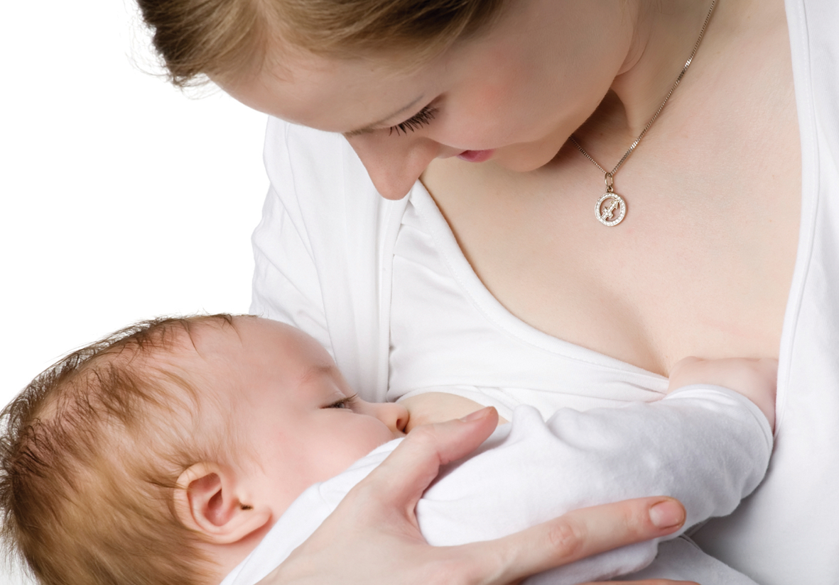
Lesson one – changing me to understand that in animals and humans lots of changes happen between birth and growing up, and that usually it is the female who has the baby to express how I feel when I see babies or baby animals
Vocabulary
Changes
Birth
Animals
Babies
Mother
Growing up

Slide 4
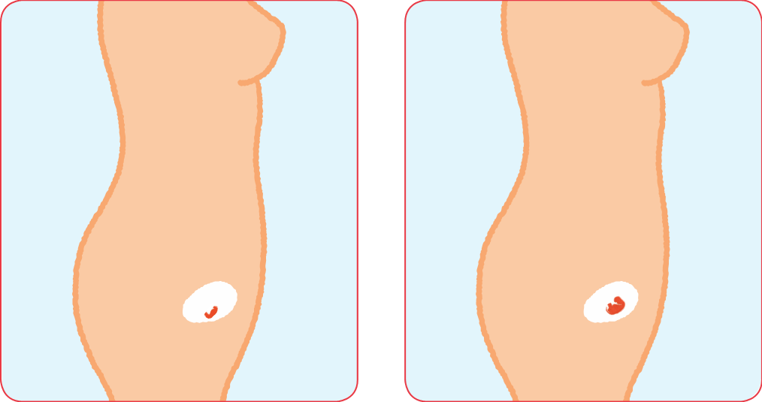
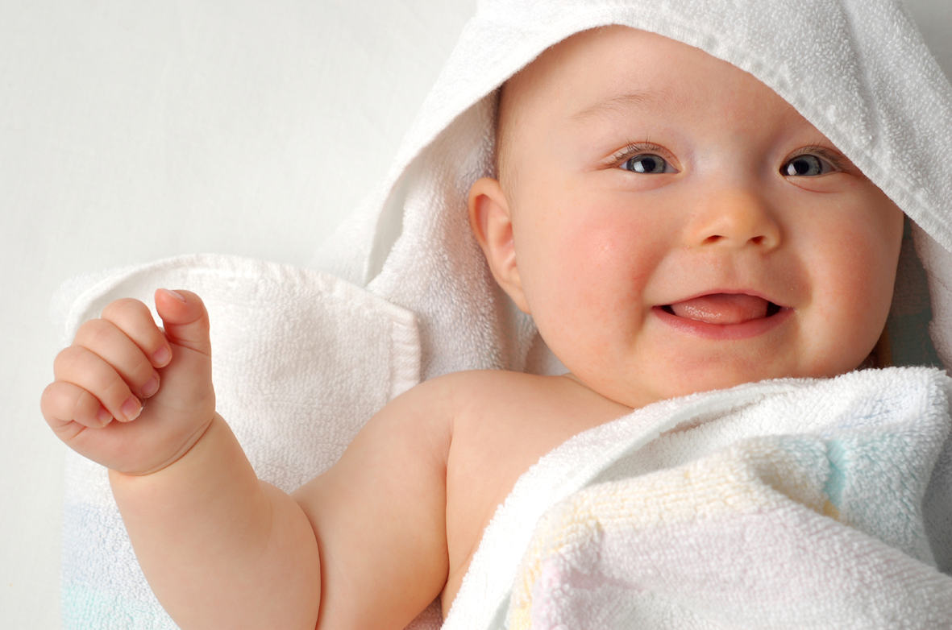
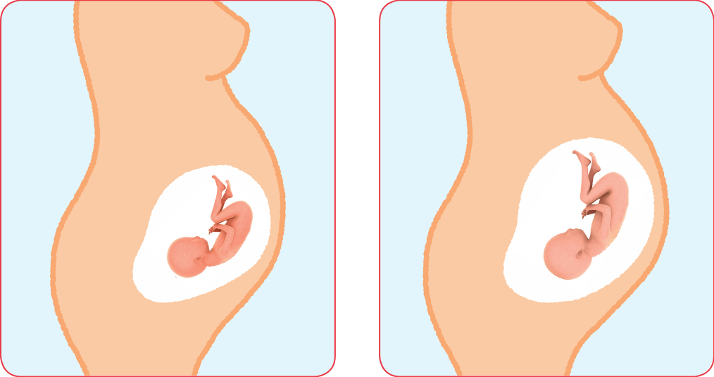
Lesson two – changing me to understand how babies grow and develop in the mother’s uterus and understand what a baby needs to live and grow to express how I might feel if I had a new baby in my family
Vocabulary
Baby
Grow
uterus
Womb
Nutrients
Survive
Love
Affection
Care

Slide 5
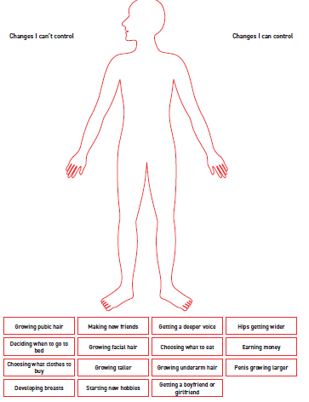
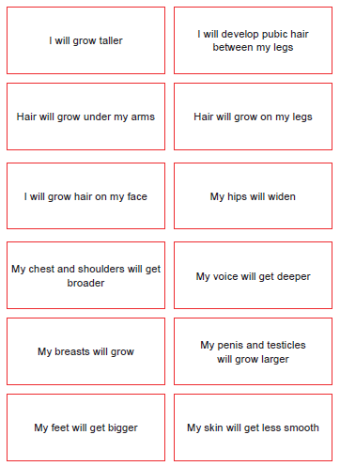
Lesson three – changing me to understand that boys’ and girls’ bodies need to change so that when they grow up to recognise how I feel about these changes happening to me and know how to cope with those feelings
Vocabulary
Change
Puberty
Control

Slide 6
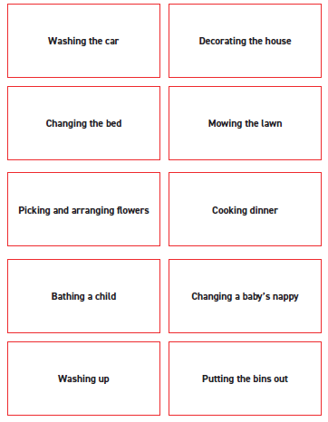
Lesson four – changing me to start to recognise stereotypical ideas I might have about parenting and family roles to express how I feel when my ideas are challenged and be willing to change my ideas sometimes
Vocabulary
Stereotypes
Task
Roles
Challenge

Slide 7
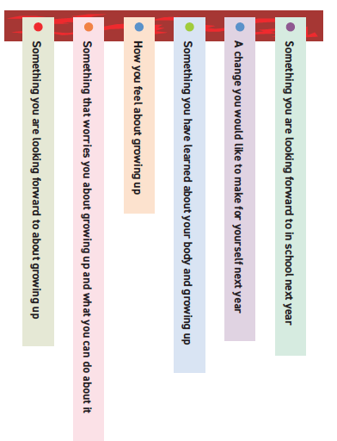
Lesson five – looking ahead to identify what I am looking forward to when I move to my next class to start to think about changes I will make next year and know how to go about this
Vocabulary
Change
Looking forward
Excited
Nervous
Anxious
Happy

Slide 8


