Slide 1
Progression of SRE at Parkside Primary School
Year 1
Year 2
Year 3
Year 4
Year 5
Year 6
Life Cycles
Changing Me
My changing body
Boys and girls bodies
Learning and growing
Coping with changes
Life Cycles in nature
Growing from Young to Old
The Changing Me
Boys’ and Girls’ bodies
Assertiveness
Looking ahead
How babies grow
Babies, how they develop in the uterus
Outside Body Change
Inside body changes
Family Stereotypes
Looking ahead
Unique Me
Internal and external parts of the male and female body
Girls and puberty
Circles of change
Accepting change
Looking ahead
Self image
Puberty for girls
Puberty for boys
Looking ahead 1
Looking ahead 2
My Self Esteem
Puberty
Babies: Conception to birth
Relationships
The year ahead

Slide 2
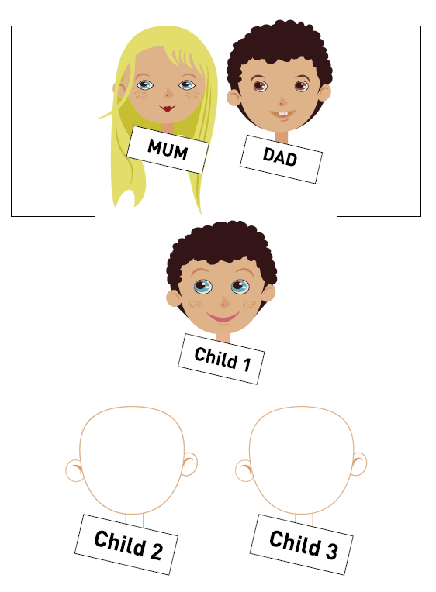
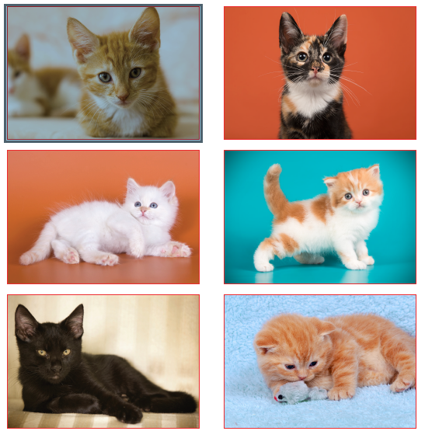
Unique Me
Understand that some of my personal characteristics have come from my birth parents and that this happens because I am made from the joining of their egg and sperm.
Appreciate that I am a truly unique human being.
Vocabulary
Personal
Unique
Characteristics
Parents

Slide 3
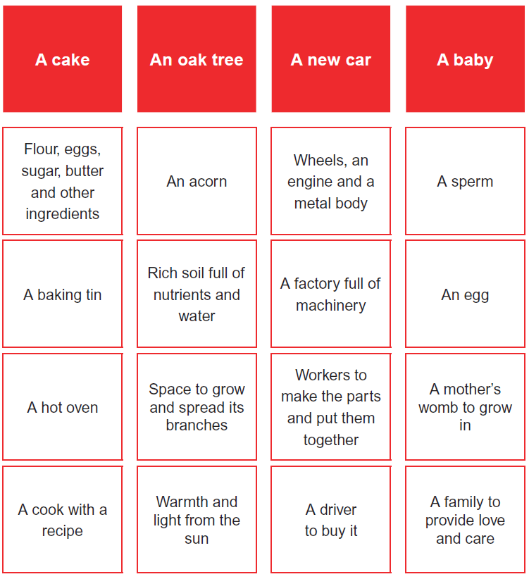
Internal and external parts of the male and female body
Correctly label the internal and external parts of male and female bodies that are necessary for making a baby.
Understand that having a baby is a personal choice and express how I feel about having children when I am an adult.
Vocabulary
Sperm
Egg/ Ovum
Penis
Testicles
Vagina/ Vulva
Womb/ Uterus
Ovaries
Sexual Intercourse
Fertilise
Conception

Slide 4
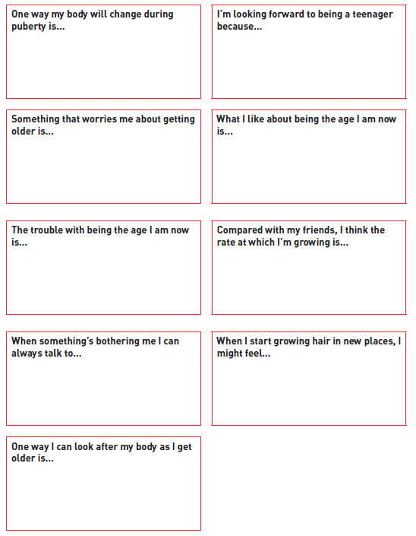
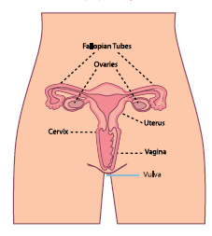
Girls and puberty
Describe how a girl’s body changes in order for her to be able to have babies when she is an adult, and that menstruation (having periods) is a natural part of this
Know that I have strategies to help me cope with the physical and emotional changes I will experience during puberty
Vocabulary
Puberty
Menstruation
Periods

Slide 5
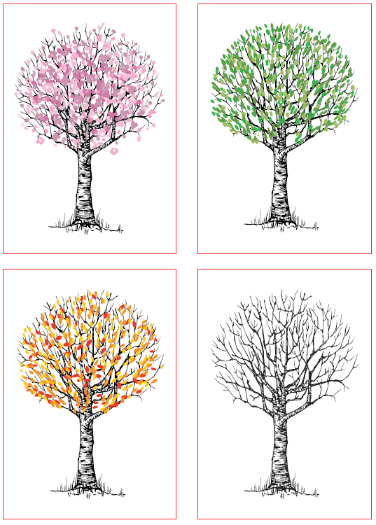

Circles of change
Know how the circle of change works and can apply it to changes I want to make in my life.
Am confident enough to try to make changes when I think they will benefit me.
Vocabulary

Slide 6
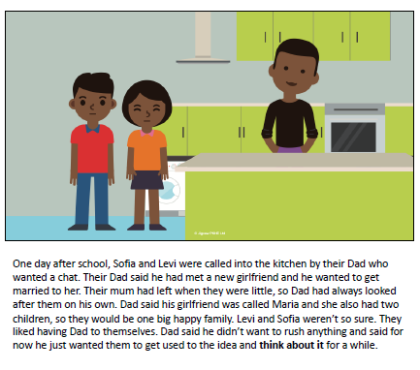
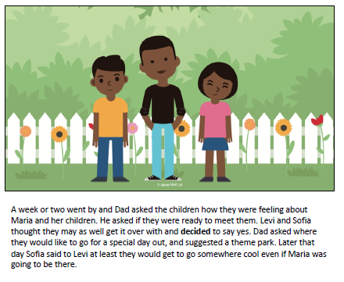
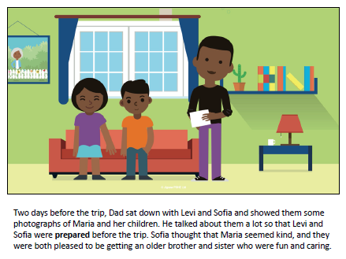

Slide 7
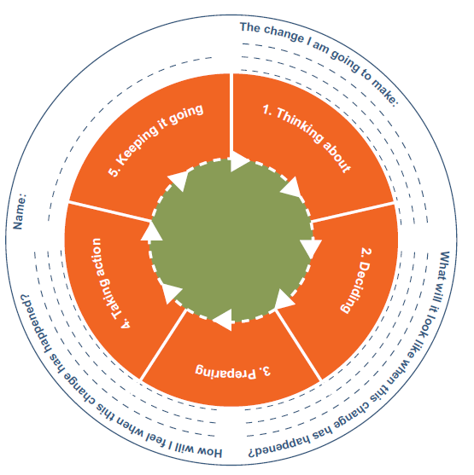

Slide 8
Accepting change
Identify changes that have been and may continue to be outside of my control that I learnt to accept.
Express my fears and concerns about changes that are outside of my control and know how to manage these feelings positively.
Vocabulary
Range of emotions - see emotions card resource
Control
Change
Acceptance

Slide 9
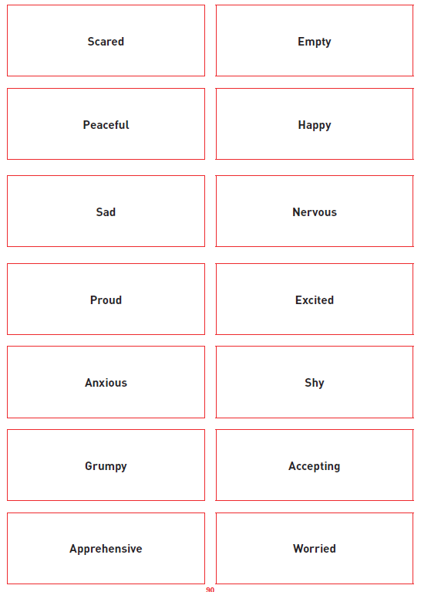
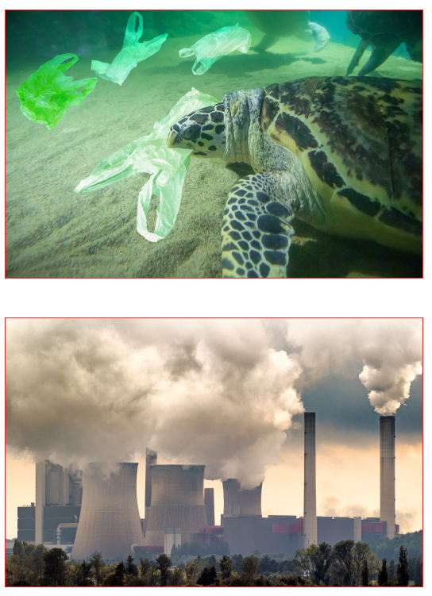

Slide 10
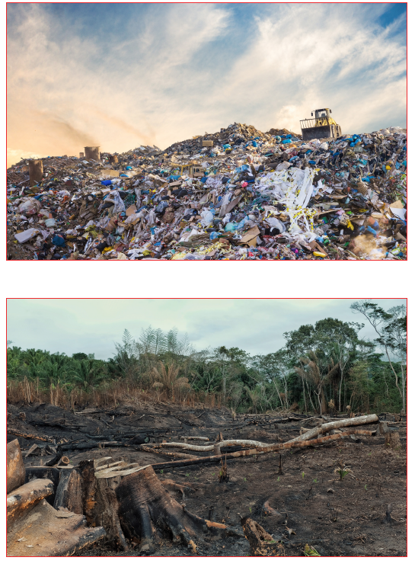

Slide 11
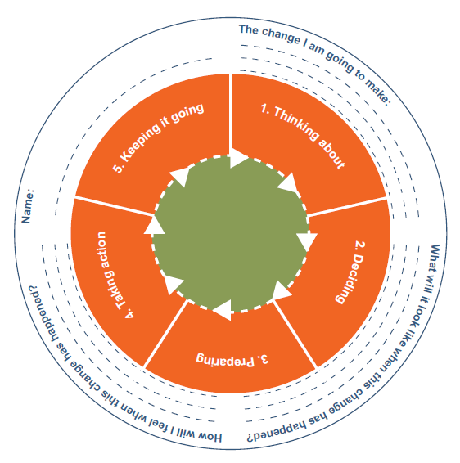
Looking Ahead
Identify what I am looking forward to when I move to a new class
Reflect on the changes I would like to make next year and can describe how to go about this
Vocabulary
Change
Looking forward
Excited
Nervous
Anxious
Happy
(See emotions cards from Piece 5)

